Slide 1
Title
Foreground-aware Dense Depth Estimation for 360 Images
Qi Feng (Waseda University), Hubert P. H. Shum (Northumbria University),
Ryo Shimamura (Waseda University), Shigeo Morishima (Waseda University)
Notes:
Lecture notes:
Hello everyone, I am Qi Feng come from Waseda University, Japan.
Today I would like to give my presentation about our paper, foreground-aware dense depth estimation for 360 degree images.

Slide 2
Background 1 (transition page)
Dense Depth Estimation from Monocular 360 Images
Background
Notes:
Lecture notes:
First, I would like to talk about previous research on estimating dense depth maps from monocular 360 degree images.

Slide 3
Depth Estimation Visualization (Animation)
* Clip from Holynski, A. et al. (2018). Fast depth densification for occlusion-aware augmented reality. TOG. 37(6), 1-11.
Notes:
Lecture notes:
Estimating a dense depth map means to estimate the distance between the camera and every pixel on the image from only color input.
For example, if we can estimate the depth of this image, we can know the distance of these chairs, the radio, or the box.

Slide 4
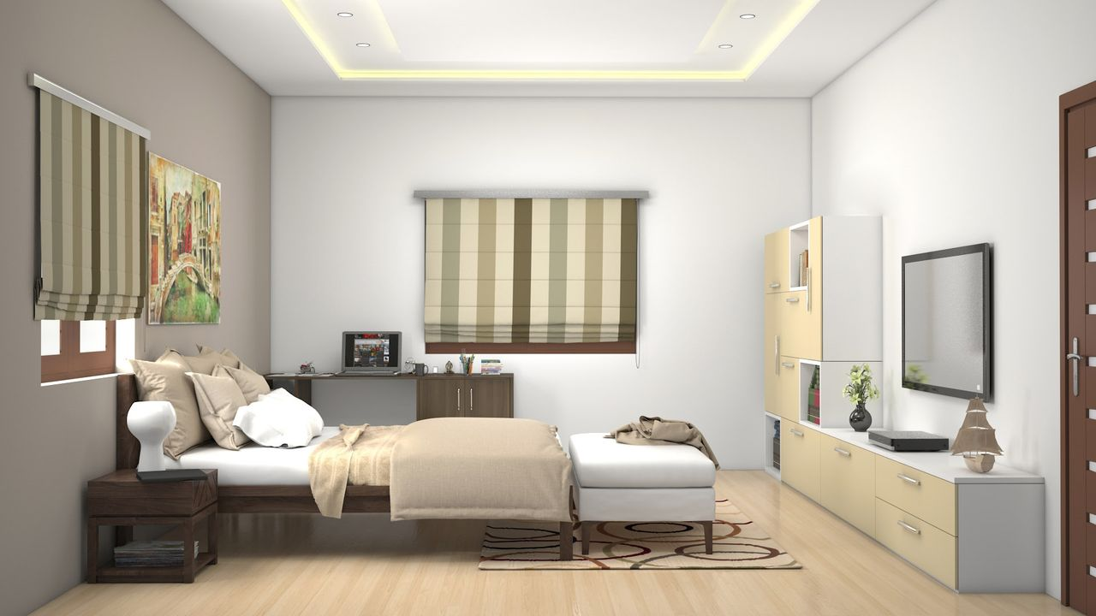
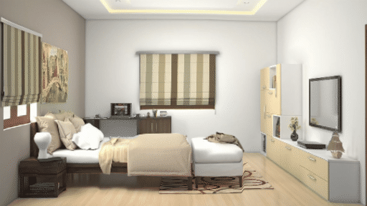
Previous 2D Depth Estimation Methods (Megadepth/Monodepth)
Li, Zhengqi, and Noah Snavely. "Megadepth: Learning single-view depth prediction from internet photos." CVPR. 2018.
Godard, Clément, et al. "Digging into self-supervised monocular depth estimation." ICCV. 2019.
Notes:
Lecture notes:
In recent years, with the advance of computer vision and deep learning technologies, by feeding neural networks with a huge amount of paired color and depth images, they can learn to predict the depth relatively well.
The ability to predict depth from a single image is very helpful in a wide range of applications.
One example here is to render a scene with a moving perspective. This is very useful in stereo rendering and virtual reality.
Another example is feeding stereo images to networks, and use the multi-view consistency to train the model.
The distance information is extremely helpful for self-driving cars and robotic navigation.

Slide 5
Previous 360 Depth Estimation Methods (Omnidepth)
Zioulis, N. et al. Omnidepth: Dense depth estimation for indoors spherical panoramas, ECCV, 2018.
However, previous methods are weak against all dynamic foreground objects:
Notes:
Lecture notes:
With omnidirectional contents become more popular and accessible, Zioulis further extends the capability to predict depth from traditional 2D images to omnidirectional images.
However, existing depth estimation algorithms are weak against dynamic foreground objects.
An example is shown here. Using the previous method, the color input is shown on the left side and the estimated depth is shown on the right side.
Without dedicate considerations of dynamic foreground objects, we can see the shape of the violinist is barely visible in the estimated depth map using the existing approach.

Slide 6
Background 2 (transition page)
Existing Datasets for Learning-based Approaches
Background
Notes:
Lecture notes:
Another major reason for low quality estimation is the dataset used in learning-based approaches.

Slide 7
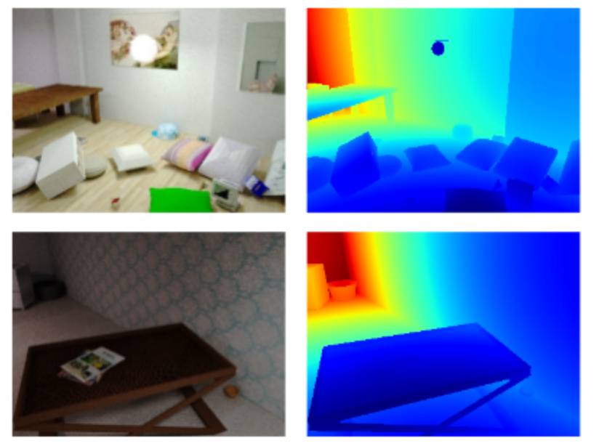
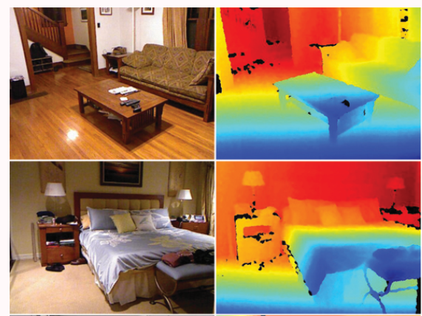
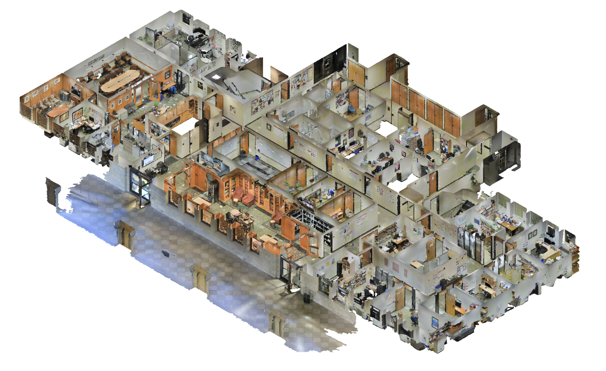
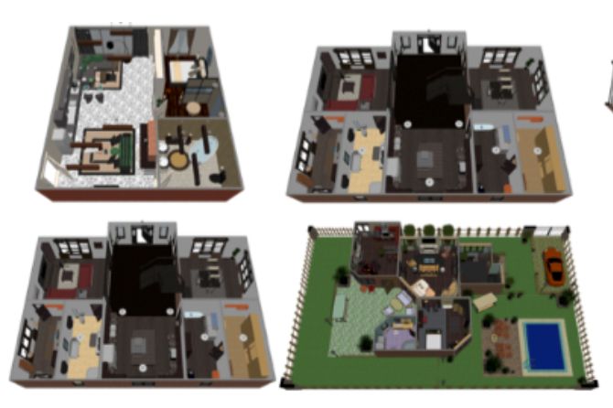
Previous Depth Estimation Dataset
Let’s have a look at different major depth-estimation dataset:
SceneNet
KITTI
NYU v2
Stanford 3D
Matterport
SunCG
Notes:
Lecture notes:
Let us take a look at popular datasets for depth estimation. The top row, SceneNet, KITTI, NYU v2 are popular for traditional 2D images, while the bottom row, Standford 3D, Matterport and SunCG are used for predicting 360 degree images.
They can be roughly divided into two categories, capture-based database that is captured with expensive and dedicate equipment, or synthesis-based database that is rendered through models and a virtual depth camera.

Slide 8
Problems with Existing Dataset
Stanford 3D
Matterport
SunCG
Notes:
Lecture notes:
For capture-based approaches, they use a scanning and stitching method.
Therefore, if there is a dynamic object appearing in the scene, there will be severe unwanted distortions in the output.
As we can see in the red dashed box, like a stretched person or a very long dog.
For synthesis-based approaches, although inserting 3D models into the scene is attempted before, as we can see on the left side. This sample comes from the SunCG dataset.
it is still challenging to efficiently generate photorealistic foreground objects that resemble real-world appearance, like the one shown on the right side.
As a result, training models with existing datasets to predict depth from 360 degree images with dynamic foreground objects usually lead to sub-optimal outputs.

Slide 9
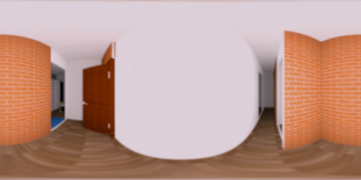
Overview of the Proposed Method 1
In this paper, we tackle the problem of foreground by
proposing a method to synthesize an RGB-D 360 dataset with photorealistic dynamic foreground representations.
Notes:
Lecture notes:
In this work, we tackle this problem by
First, proposing a method to synthesize an RGB-D 360 dataset with photorealistic dynamic foreground representations.

Slide 10
Overview of the Proposed Method 2
In this paper, we tackle the problem of foreground by
employing an auxiliary network that estimates depth and segmentation masks to calculate a new local depth loss of dynamic foreground objects to improve the estimation results of local regions.
$$L_{global}$$
$$L_{local}$$
Notes:
Lecture notes:
Second, employing an auxiliary network that estimates depth and segmentation masks to calculate a new local depth loss of dynamic foreground objects to improve the estimation results of local regions.

Slide 11
Methodology 1 (transition page)
Foreground-aware Photorealistic 360 Dataset
Methodology
Notes:
Lecture notes:
I will first talk about how we synthesize the foreground-aware photorealistic 360 degree dataset.

Slide 12
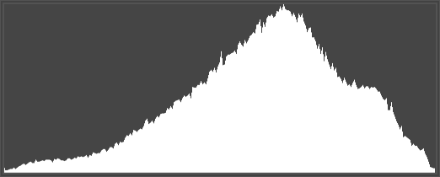
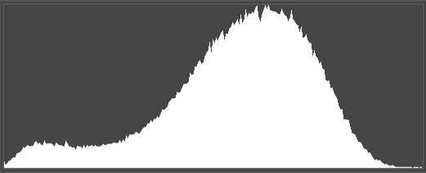
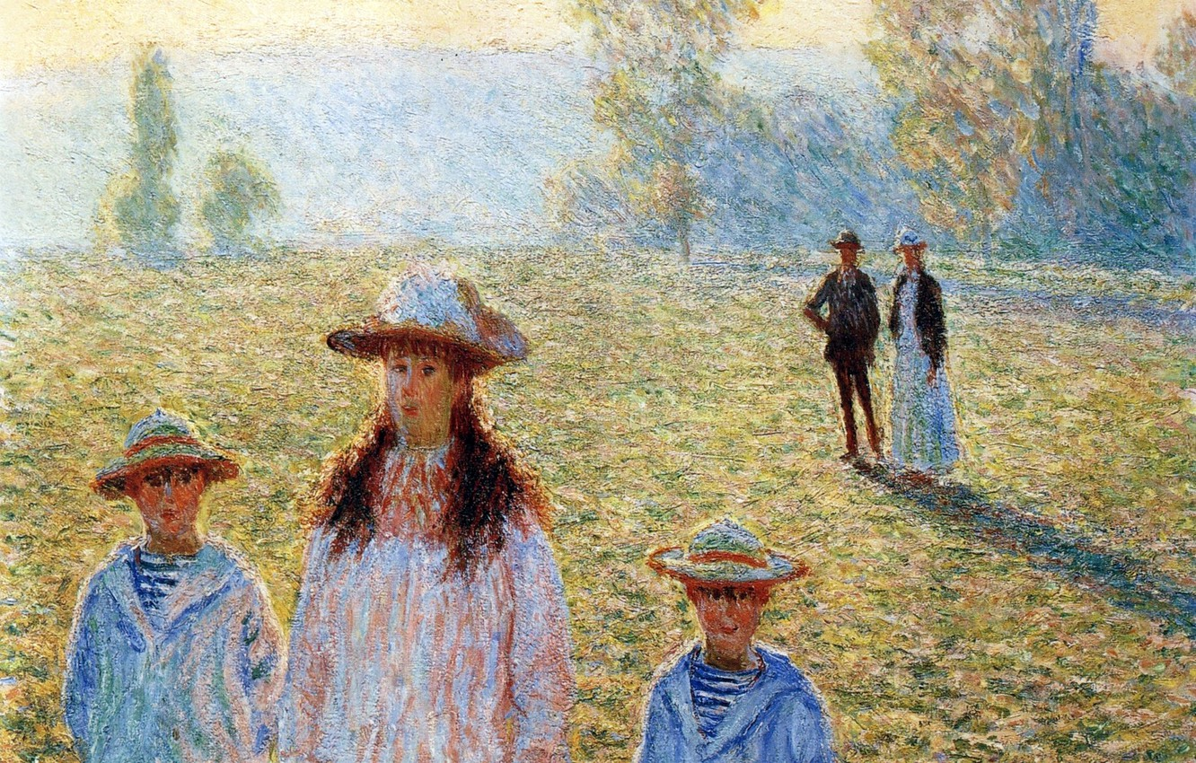
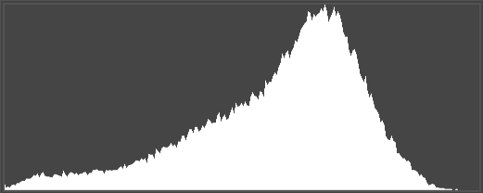
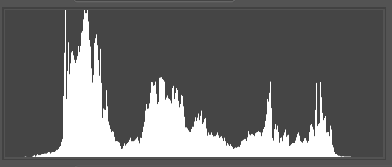
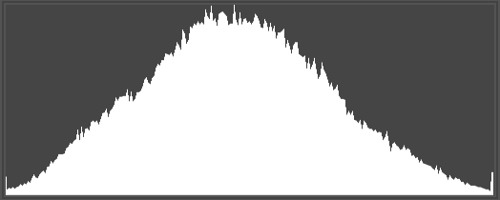
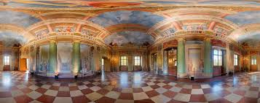
Observation of 360 Images
Before transformation
After transformation
Color histogram
Depth of
interested region
…
…
Notes:
Lecture notes:
We observe that it is very difficult to establish a correspondence between the color and depth information in traditional 2D images. It’s like If we keep "zooming in" onto the two persons marked in the first picture, the color histogram of cropped pictures will change continuously while the depth should always stays the same.
Like using binoculars to see the same object, even if we have already known the size of the object, it is still very difficult for us to use this knowledge and estimate the distance without knowing the magnification.
However, for 360 degree images, if the distance of the target object is already fixed, there will only be one scale of the target. This one-to-one mapping is very beneficial for both our data synthesis and training of the neural network.

Slide 13
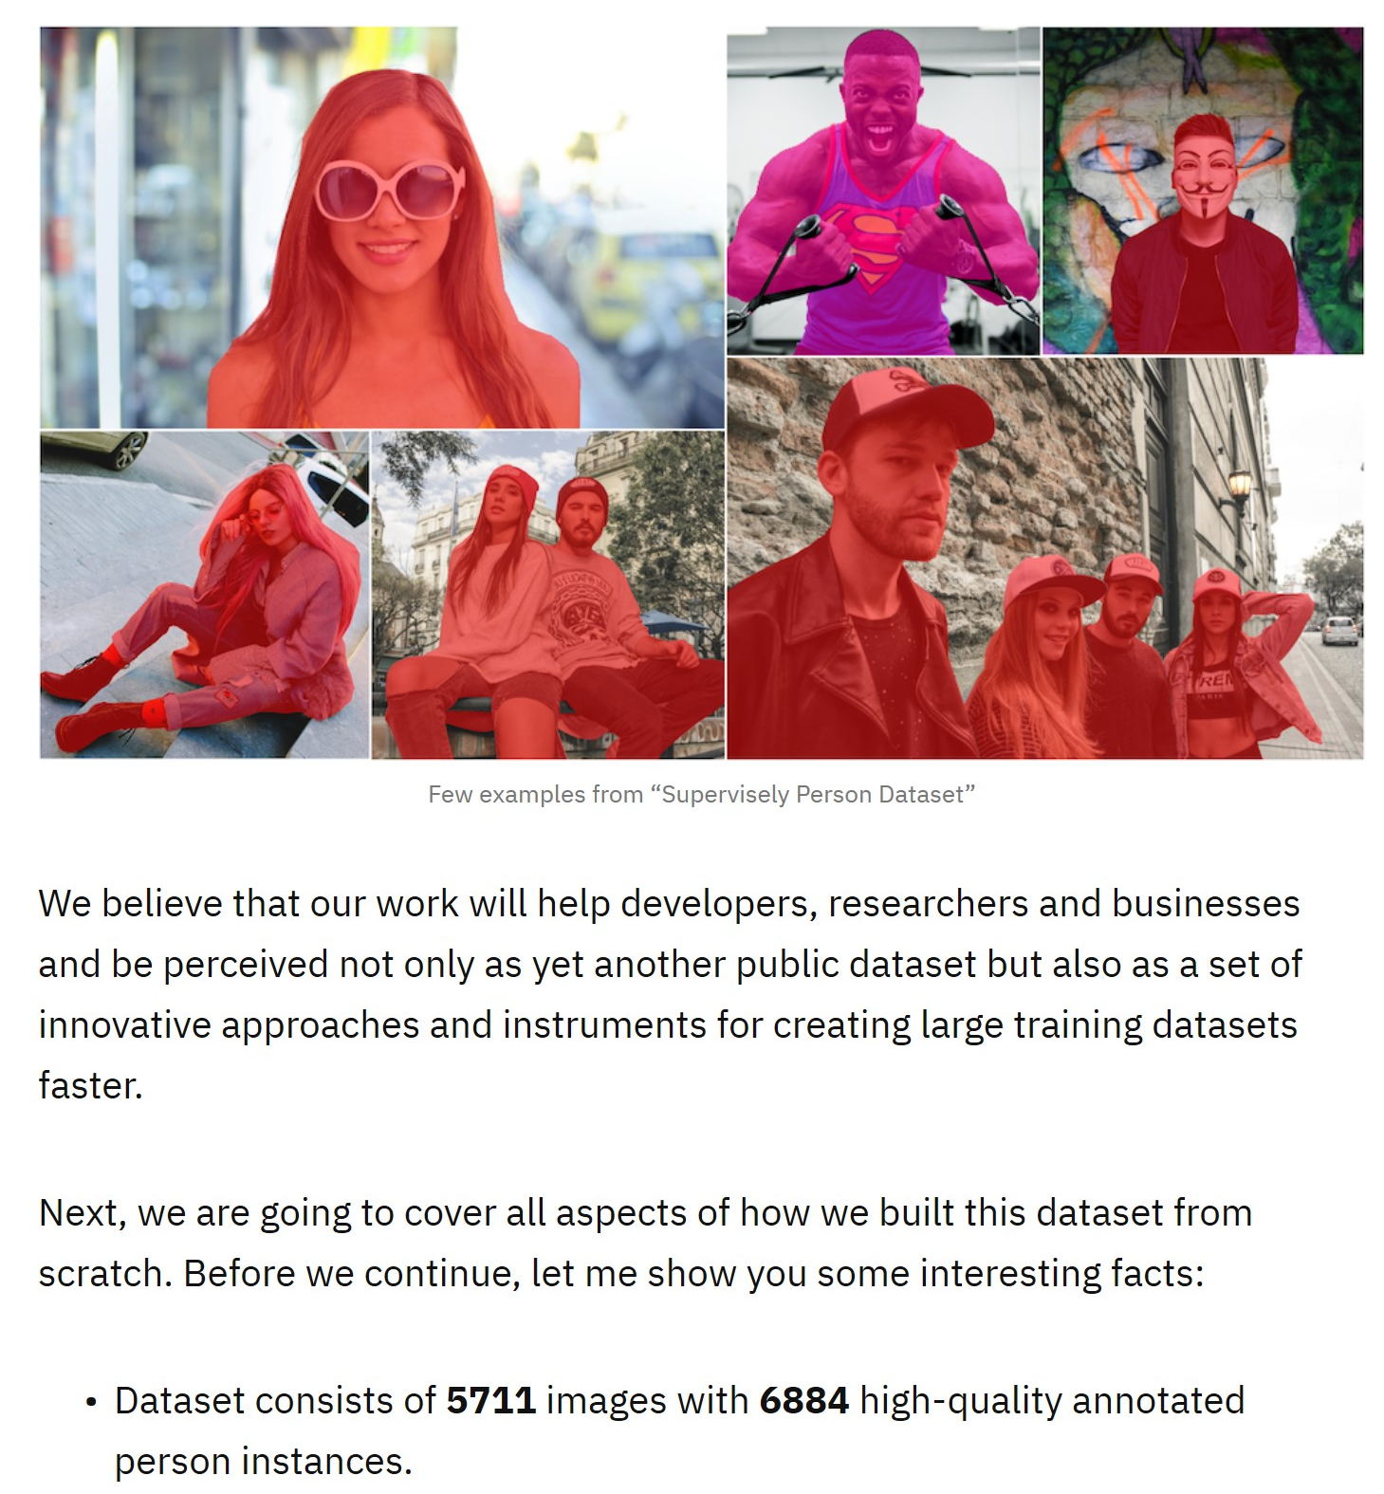
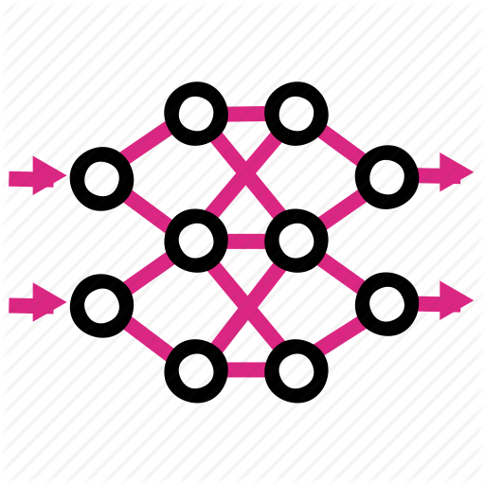
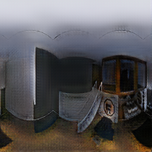
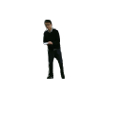
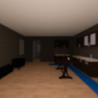
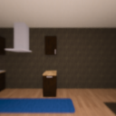
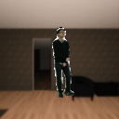
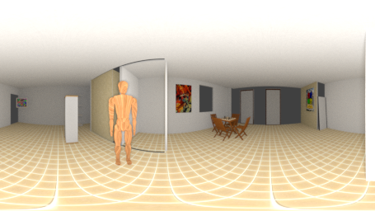
Pipeline of Data Augmentation
Input
Depth
Output
RGB
Segmentation mask
C
D
M
D
M
C
D
C
COCO
Mask of interest
Paired RGB-D
D
Mask R-CNN
D
C
Human pose datasets
D
C
C
360°datasets
Cubemap
Proposed dataset
Notes:
Lecture notes:
Therefore, to synthesize a foreground-aware photorealistic 360 degree RGB-D dataset, we take human as an example and demonstrate the process.
We first capture or use existing 2D RGB-D dataset that is captured with a RGB-D sensor, like a Kinect.
In this work, we reuse a captured dataset for human pose estimation.
By passing the color information through a mask R-CNN model pretrained with COCO dataset, we can obtain masks of interested targets.
With that being available, we can acquire paired color and depth information.
To synthesize omnidirectional images with correct distortions, we project existing 360 degree images into cube maps. By compositing color information according to the depth information, we can then obtain the desired dataset.

Slide 14
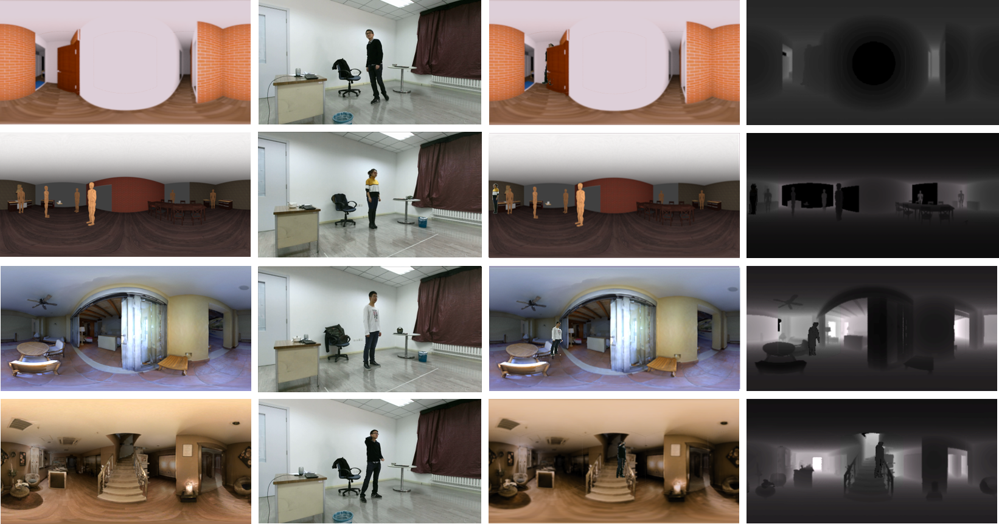
Generated Dataset
Notes:
Lecture notes:
Here are some generated samples. The first column is the original 360 degree images without any foreground object.
The second column is the image acquired form a traditional 2D image dataset.
The third column is the synthesized color images, and the last column is the corresponding depth maps.
As we can see, we successfully added photorealistic objects onto existing omnidirectional images with correct depth annotations.

Slide 15
Methodology 2 (transition page)
Depth Estimation for
Omnidirectional Images
Methodology
Notes:
Lecture notes:
With a 360 degree dataset including dynamic objects being available, we will then talk about our foreground-aware learning-based approach to estimate the depth.

Slide 16
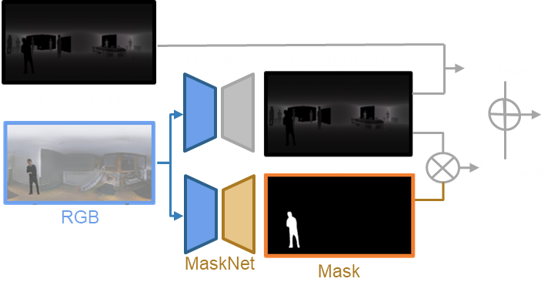
Network overview
$$L_{total}=\sum_{i}{{(α}_{i}L_{depth}+β_{i}L_{smooth}+ })$$
$$γL_{local}$$
$$L_{local}={\left\|D_{pred}×M_{local}\right\|}^{2}$$
Notes:
Lecture notes:
We use two fully-convolutional encoder-decoder structured networks, RectNet and MaskNet.
We leverage the generated masks of interested areas to train the auxiliary MaskNet, and predict the region of interest when a color image is input.
The RectNet is trained to regress the depth from the color image.
A new local depth loss term is calculated to ensure that those small regions with a steep gradient change are not smoothed out when optimizing the depth estimation, which was a problem in previous methods.

Slide 17
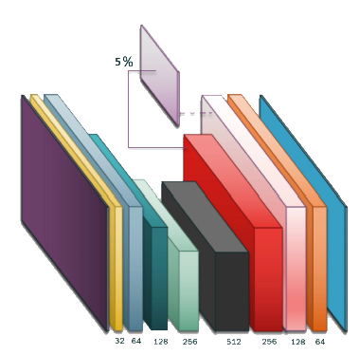
More Details of the Network
5%
Input
res1
Output
res2
up2
res3
res4
up1
Res5
ResNet-101
RectNet
MaskNet
Notes:
Lecture notes:
Both networks progressively downscales and up-scales to the target representation, skip connections similar to ResNet structures help to preserve the information from a higher level.
For the RectNet, the encoder consists of two preprocessing blocks (yellow and blue) and a downscaling block (dark green), followed by two increasing dilation blocks (light green and black),
and the decoder contains three up-prediction blocks, followed by a prediction layer.
With 360 degree color images in equirectangular format as the input, it predicts the corresponding depth map.
For the MaskNet, the encoding and decoding parts are not symmetrical, with the decoder being shallower.
With 5 downscaling blocks and 2 upscaling blocks, it predicts an equirectangular segmentation mask from an color image.

Slide 18
Experimental Results
Notes:
Lecture notes:
Here are the experimental results of our approach.

Slide 19
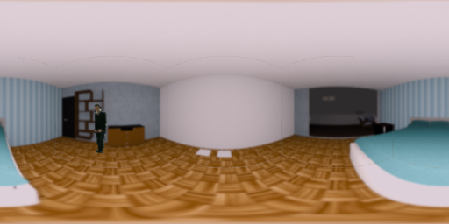
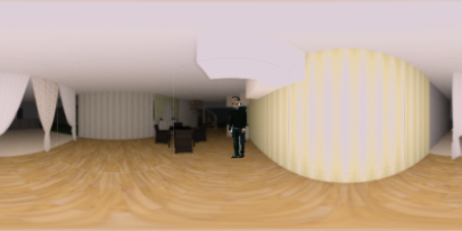
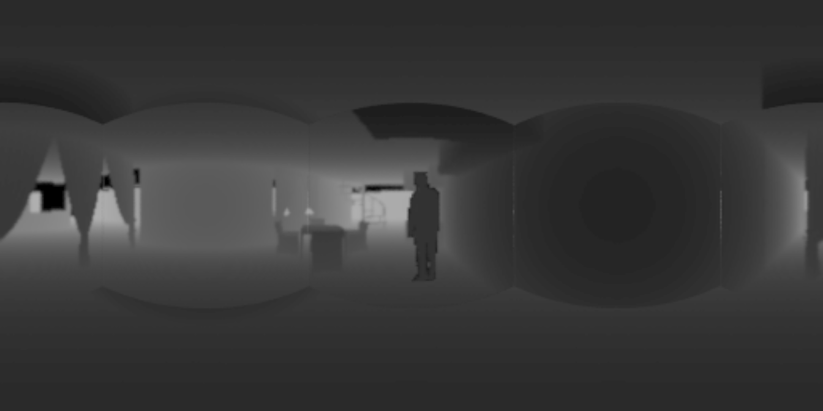
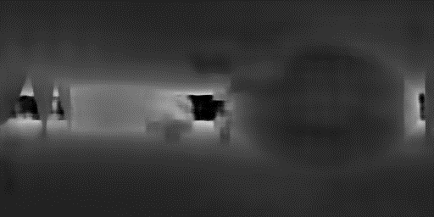
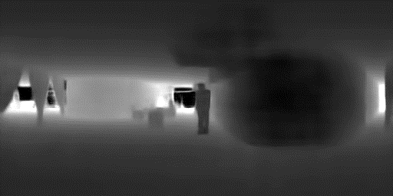
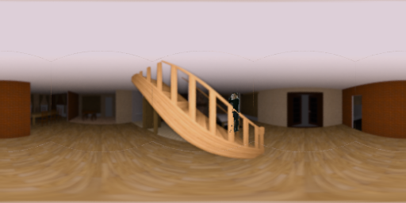
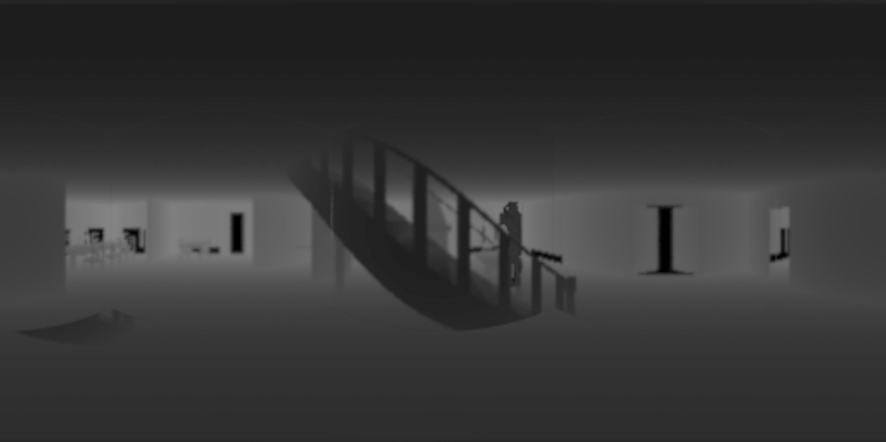
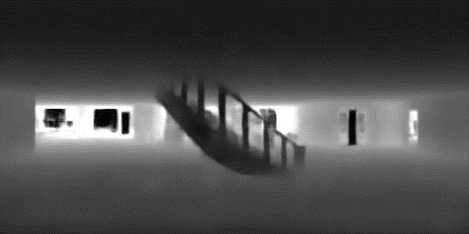
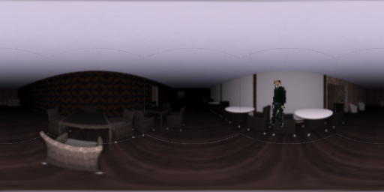
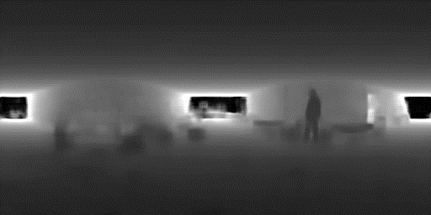
Results 1
Input
Ground Truth
Zioulis et al.
Proposed
Notes:
Lecture notes:
As the input color images shown in the first column and ground truth depth maps shown in the second column, the third column shows the result estimated with the previous method, proposed by Zioulis. Results estimated with our proposed approach is shown in the last column.
If we focus on the regions of the person. We can clearly see that they got smoothed out with the previous method, but well preserved with our method.

Slide 20
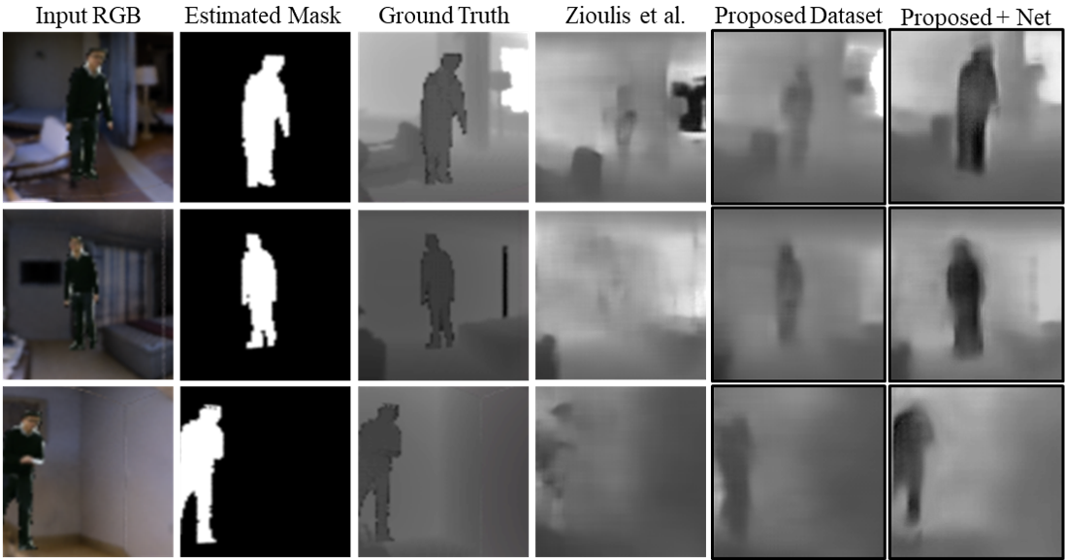
Results 3
Notes:
Lecture notes:
Here are the results when we zoom in onto the interested areas.
The first column is the input RGB images, the second is the corresponding segmentation mask estimated with the MaskNet. The third column shows the ground truth depth map. The fourth column shows the estimated depth map with the previous method. The fifth column shows the result estimated with the model from the previous work trained with our proposed dataset,
and the last shows the result of our model trained with our proposed dataset.

Slide 21
Results 2
Absolute relative difference (Abs Rel), squared relative difference (Sq Rel), root mean square error (RMSE) and RMSE log, lower values are better. For percentage of inliers under threshold, $δ<1.25$, $δ<{1.25}^{2}$and $δ<{1.25}^{3}$, higher values are better.
Notes:
Lecture notes:
By using the metrics widely adopted in depth estimation research, we ablatively and quantitatively evaluate the usefulness of both our dataset and our network.
For Absolute relative difference, squared relative difference, root mean square error and root mean square error log, a lower value means higher accuracy. For percentage of inliers under threshold, a higher percentage means higher accuracy.
In table 1, with both a synthetic 360 degree dataset augmented with human and a captured 360 degree dataset augmented with human, trained with the same model proposed in the previous work, we have improved the accuracy across the board.
In table 2, we use the same augmented dataset to train the previous model and our proposed model. As we can see in the table, we also achieved a higher accuracy for both synthetic and photorealistic inputs.

Slide 22
Notes:
Lecture notes:
Here are more results tested the photorealistic dataset. The first three rows are RGB input, estimated masks and ground truth depth, while the last three rows are results estimated with the previous method, results estimated with our proposed dataset, and our proposed dataset combined with the proposed network.

Slide 23
Outro
Thank you for watching
If there is any question, You can find me at fengqi@ruri.waseda.jp
Notes:
Lecture notes:
More details can be found in the paper and the supplementary material.
If you have any further question, you can send me an email to discuss with me.
That is all, and thank you for watching!

