Slide 1
Simulating Multiple Character Interactions with Collaborative and Adversarial Goals
Hubert P. H. Shum RIKEN
Taku Komura University of Edinburgh
Shuntaro Yamazaki AIST

Slide 2
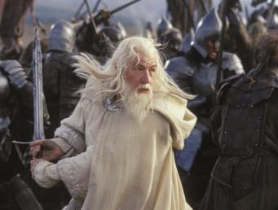
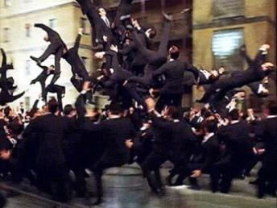
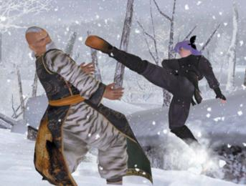
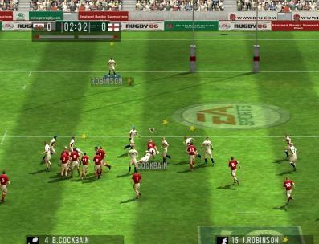
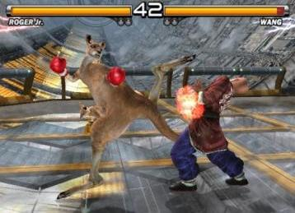
Character Animation - Huge Demand but Little Research, Especially for Interactions

Slide 3
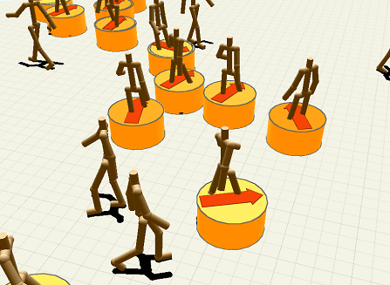
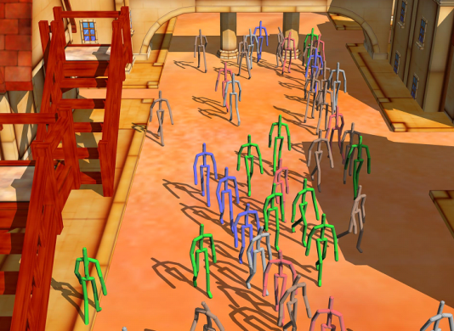
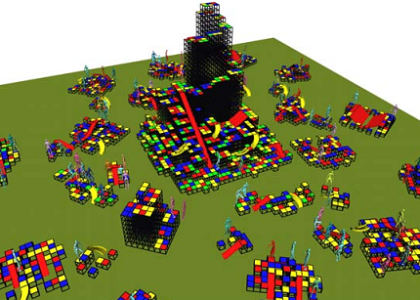
Crowd Simulation Researches - No Dense Interaction Among Characters
Treuille et. al. 2007 Near-Optimal Character Animation with Continuous Control
Kwon et. al. 2008 Group Motion Editing
Lee et. al. 2007 Motion Patches

Slide 4
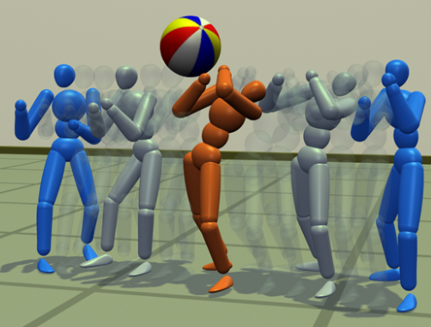
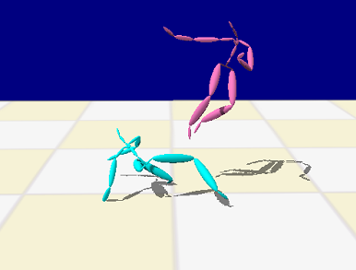
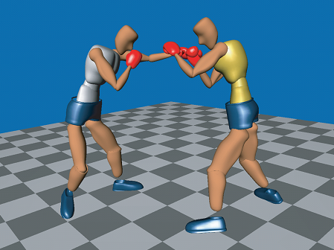
Interaction Simulation Researches - Cannot Generate Complex and Multi-Character Interactions
Zordan et. al. 2007 Anticipation from Example
Park et. al. 2004 Analysis and Synthesis of Interactive Two-Character Motions
Lee et. al. 2006 Precomputing Avatar Behavior from Human Motion Data

Slide 5
Motion Capture with Single Actor - More Easy and Safe Motion Capture

Slide 6
Action Level Motion Graph - Reorder Captured Motion to General New Motion
Punch
Dodge
Avoid
Walk
Kick
Avoid
Avoid
Punch
Walk
Punch
Walk
Kick
Dodge
Kick
Dodge

Slide 7
Game Tree Expansion - Predict Future States to Select Optimal Immediate Actions
Objective Function
Damage to Enemy minus Damage from Enemy
Movement toward Enemy
Rotation toward Enemy
State of Interaction
Distance
Facing Angles
Postures
Max Nodes
Optimal Action
Min Nodes
+S1
+S2
Max. Score
+S1 –S4
+S2 –S8
-S3
-S4
-S5
-S6
-S7
-S8
+S1 -S3
Min. Score
+S1 –S4
+S1 –S5
Min. Score
+S2 –S6
+S2 –S7
+S2 –S8

Slide 8
Simulating Interactions - Characters Interact Intelligently Like Real Human

Slide 9
Two Characters Chasing One - Expanding a Game Tree of Three Characters

Slide 10
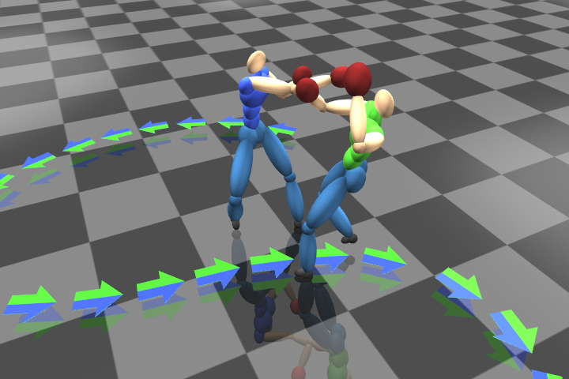
Problem in Cooperation with Minmax - The Character Actively Prevents the Opponent to Follow Orders

Slide 11
Problem in Cooperation with Minmax - The Character Actively Prevents the Opponent to Follow Orders
Competitive Function
Damage to Enemy minus Damage from Enemy
Movement toward Enemy
Rotation toward Enemy
+S1
Cooperative Function
Follow Animator Designed Trajectory
Follow Animator Designed Actions
-S3
-S4
-S5
The character selects the action that such that the enemy cannot follow animator’s command
+S1 -S3
+S1 –S4
+S1 –S5
Min. Score

Slide 12
A Redesigned Framework - Evaluating Competition and Cooperation Separately
Evaluate the score of competition and cooperation separately
Apply Minmax for competition score
Apply dynamic programming for cooperation score
Optimal Action
+S1^{Competitive}
S1^{Cooperatvie}
-S1
-S5^{Competitive}
S5^{Cooperatvie}
-S3^{Competitive} S3^{Cooperatvie}
-S5
Max. Score
-S3
+S1^{Competitive}-S4^{Competitive} +S1^{Cooperative}+S4^{Cooperative}
-S4
-S4^{Competitive}
S4^{Cooperatvie}
Min. Score
+S1^{Competitive}-S3^{Competitive} -S1^{Cooperattve}-S3^{Cooperative}
+S1^{Competitive}-S4^{Competitive} -S1^{Cooperative}-S4^{Cooperative}
+S1^{Competitive}-S5^{Competitive} -S1^{Cooperative}-S5^{Cooperative}
+S1-S3
+S1–S4
+S1–S5

Slide 13
Fighting in a Formation - Animator Designed Movement Trajectories

Slide 14
Changing Interaction Style - Aggressive Infighter and Defensive Out-boxer

Slide 15
Chasing in a Crowded Environment - Animator Designed Trajectories and Timing

Slide 16
Scene with a Storyline - Strong Fighter Crashed by a Car

Slide 17
Scene with a Storyline - Weak Fighter Saved by a Hero

Slide 18
Thanks!
Any Questions?

