Slide 1
Real-Time Posture Reconstruction for Microsoft Kinect
Hubert P. H. Shum Northumbria University
Yang Jiang Northumbria University
Edmond S. L. Ho Hong Kong Baptist University
Shu Takagi University of Tokyo

Slide 2
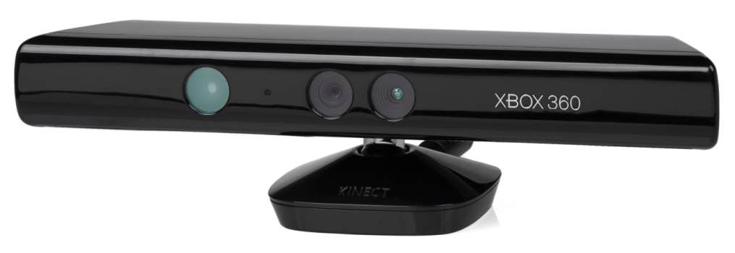
Microsoft Kinect
Features
Depth and color sensors
Body posture estimations
Challenges
Some body parts may be unavailable, and tracked part may be unreliable
Need to reconstruct the true body posture

Slide 3
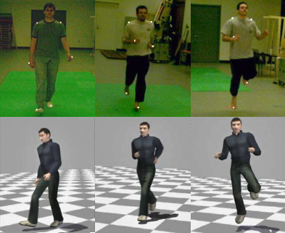
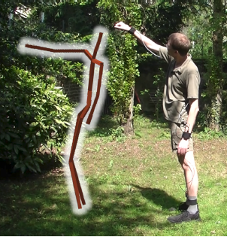
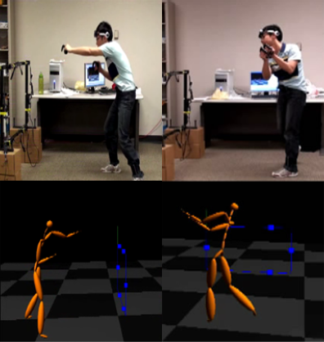
Previous Works
Chai et al. 2005 Performance Animation
from Low-Dimensional Control Signals
Tautges et al. 2011 Motion Reconstruction using Sparse Accelerometer Data
Liu et al. 2011 Realtime Human Motion Control with A Small Number of Inertial Sensors
Notes:
assume the reliability of the input
assume full body input
need to interact with virtual environment

Slide 4
Reliability Estimation
Noisy tracking due to the occlusion problem and the small capture area
Need to evaluate the reliability of the tracked joints

Slide 5
Behaviours Reliability Term
The presence of abnormal behaviour of a tracked parts
In Kinect, we consider the high frequency vibration of part positions
Ɵ_{i} is the angle change of the displacement vector in the past frames for body part i
Ɵ_{roof} and Ɵ_{floor} are used for normalization
f_{b} is the number of frames we considered for the evaluation
e.g. In our setup, we consider 135º angle change per frame on average over the past 3 frames to be abnormal
Possible designs in other systems
In traditional optical and magnetic motion capturer, we could consider the vibration of the track points

Slide 6
Kinematics Reliability Term
The kinematic correctness of the recognized posture
In Kinect, we consider the consistency of segment length
d_{s} is the ratio of difference of segment length comparing to the reference value
s_{part_total} is the total number of body parts
Possible designs in other systems
In traditional optical motion capturer, we could monitor the distance between markers
In magnetic and mechanical motion capturer, we could monitor segment orientation limit

Slide 7
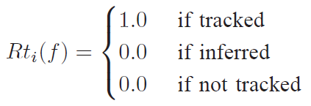
Tracking State Reliability Term
The tracking state based on hardware feedback
In Kinect, the state “tracked”, “inferred” and “not tracked” is provided
Possible designs in other system
In optical motion capturer, we could monitor if a marker is tracked
In accelerometer motion capturer, we could monitor if the forces exceed the sensor limit

Slide 8
Reliability Value
Combine the three reliability terms
Include a Gaussian filter over the past f_{total} frames to stabilize the reading

Slide 9
Reliability Estimation Results

Slide 10
True Posture Reconstruction
Part of the Kinect data is unreliable or even unavailable
A typical machine learning problem
Need to “guess” the true posture of the user
Estimate based on a motion database
Consider the reliable parts more, consider the unreliable parts less

Slide 11
Traditional Machine Learning
Sample Data in Database
Abstraction of Data
Run-time Query
Value Estimation

Slide 12
Lazy Learning
Sample Data in Database
Run-time Query
Run-time Abstraction of Data
Value Estimation

Slide 13
Traditional Machine Learning vs. Lazy Learning
Traditional machine learning
Learning is done in a pre-processing stage
Need large memory to store pre-computed results
Low run-time computational cost
Cannot embed run-time information during learning
Need prediction/quantization of run-time information
Lazy learning
Postpone all learning process to run-time
Minimal memory
More run-time computational cost
Can embed the exact run-time information in learning
More efficient training and more accurate results
Motion database is huge and run-time information is high dimensional
Traditional machine learning is nearly impossible
Apply lazy learning and consider run-time information for learning

Slide 14
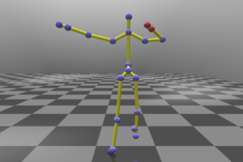
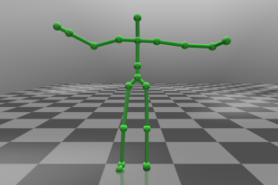
Lazy Learning in Posture Reconstruction
Kinect Recognized Posture
Motion Database
Natural Posture Space
Synthesized Posture
Reliability Evaluation
K Nearest Neighbours Search
Posture Optimization

Slide 15
Lazy Learning with Local Principal Component Analysis
Local Principal Component Analysis
Find the K Nearest Neighbour postures from a motion database that are similar to the Kinect posture
Distance function considers the reliability value of each body part
Apply Principal Component Analysis (PCA) to reduce the redundant dimensions
Result: Natural Posture Space
A low dimensional space that contain natural postures similar to the true posture
Apply optimization to find the true posture in the space

Slide 16
Control Energy Term
Guide the optimized posture towards the Kinect posture
Minimize the difference between the Kinect posture and the optimized posture
p^{x} is the optimized posture
p^{k} is the Kinect posture
Notice that the distance function considers the reliability value as weight for the body parts

Slide 17
Style Energy Term
Encourage the optimized posture to follow the movement style in the natural posture space
Minimize the difference between the optimized posture and the corresponding nearest neighbour in the natural posture space
i^{total} is the total number of parts
p^{n} is the neighbour that is the most similar to the optimized posture, p^{x}

Slide 18
Kinematics Energy Term
Make sure the optimized posture obey kinematics constraints
Minimize the different of the segment lengths in the optimized posture with respect to that of the database posture
l^{x} is the segment length in the optimized posture
l^{database} is the reference segment length
s_{total} is the total number of segments

Slide 19
Movement Continuity Term
Maintain smooth movement across frames
Minimize the square difference of velocity for each body parts with respect to the previous frame
p^{x} is the optimized posture
p^{x-1} is the optimized posture in the last frame
p^{x-2} is the optimized posture two frames before

Slide 20
Posture Optimization in the Natural Posture Space
Local Stochastic Search
In each optimization step, a number of postures are randomly sample on the natural posture space
Evaluate the total energy for the samples, and pick the optimal one with minimal energy
Continue to sample around the optimal result, until:
Energy cannot be minimized further
The total number of steps exceeds a predefined value
w_{c} = 1.0, w_{s} = 0.5, w_{k} = 1.5, w_{m} = 0.25

Slide 21
Comparison – Our Method

Slide 22
Comparison – Without Reliability Estimation and Optimization

Slide 23
Comparison – Without Reliability Estimation

Slide 24
Experiment Setup
Hardware
Intel Core i7-2630 CPU (2.00GHz)
8GB RAM
GeForce GTX 560M
36.7 frame per second
Motion Database
21590 raw postures
Filtered into 2574 by removing similar postures

Slide 25
Holding a Box

Slide 26
Holding a Flipchart

Slide 27
Playing with a Basketball

Slide 28
Sitting on a Chair

Slide 29
Perceptual Analysis

Slide 30
Conclusion and Discussions
Posture reconstruction framework for Microsoft Kinect
Designing a set of measurements to evaluate the reliability of tracked body parts
Creating a natural posture space using local PCA with runtime information
Synthesizing a stable full body posture with optimization
Applicable in other systems such as optical mocap
Potentially enhancing multi-user applications
Potential applications on sport training and rehabilitation

Slide 31
Thanks!
Any Questions?

