Slide 1
A Quadruple Diffusion Convolutional Recurrent Network for Human Motion Prediction
Qianhui Men Edmond S.L. Ho Hubert P.H. Shum Howard Leung

Slide 2
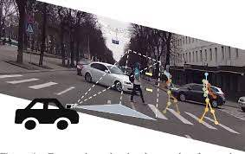
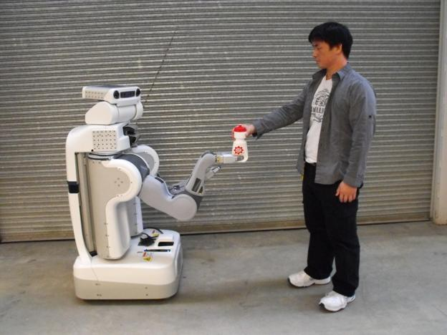
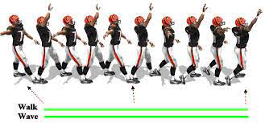


Introduction
Skeleton-based Human Motion Prediction
Applications
$$X$$
$$\hat{X}$$
…
Predictor
…
…
time
motion history
short-term prediction
long-term prediction
autonomous driving
motion synthesis
human-robot interaction

Slide 3
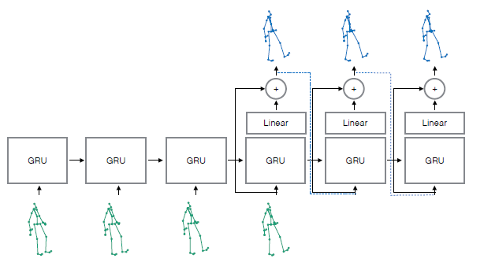
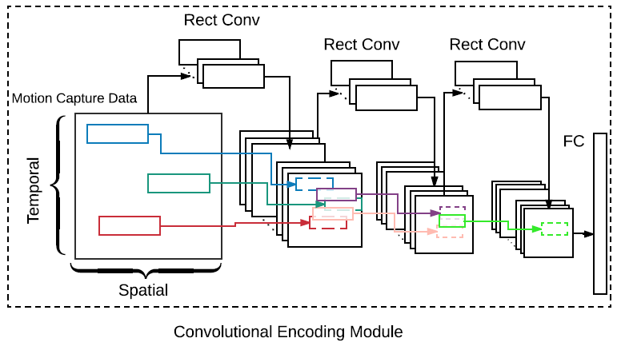
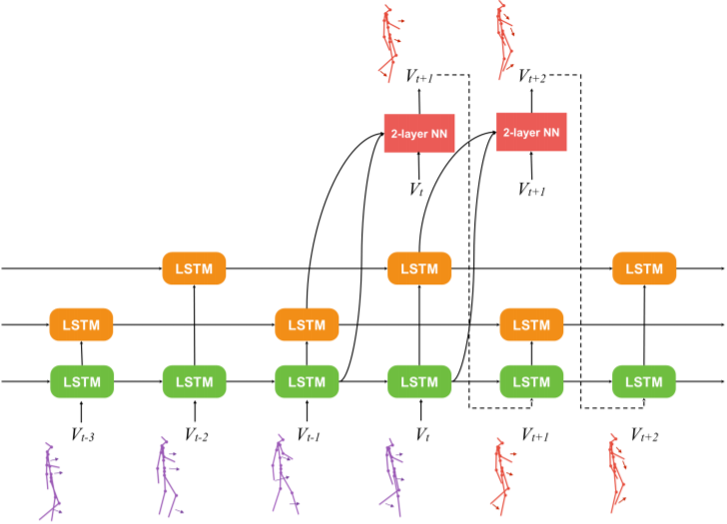
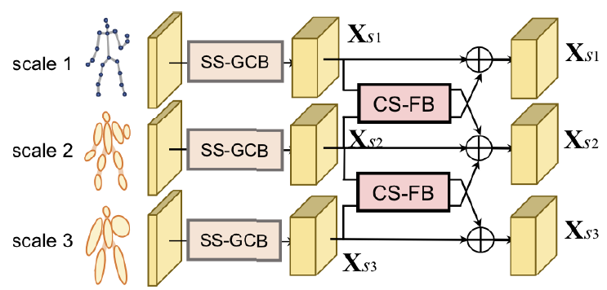
Related Work
Residual RNN [Martinez et al. 2017]
Convolutional seq2seq [Li et al. 2018]
Triangular-prism RNN [Chiu et al. 2019]
Dynamic multiscale GNN [Li et al. 2020]

Slide 4
Motivations
Problems in past work
  Spatial---Generating unnatural poses or artifacts
    Causes: No/Bad modeling of spatial correlations → Our solution: Graph convolutions for modeling spatial dependencies
  Temporal---Short-term discontinuity
    Causes: Dynamic is not observed in motion history → Our solution: Modeling motion gradient (i.e., velocity) instead of raw position
  Temporal--- Long-term Mean Poses
    Causes: Motion drift with error propagation → Our solution: GAN to revise long-term motion trend
Input
GT
…
…
…
…
Prediction
Unnatural pose
Mean poses
Discontinuity

Slide 5
Motivations
Problems in past work
  Spatial---Generating unnatural poses or artifacts
    Causes: No/Bad modeling of spatial correlations → Our solution: Graph convolutions for modeling spatial dependencies
  Temporal---Short-term discontinuity
    Causes: Dynamic is not observed in motion history → Our solution: Modeling motion gradient (i.e., velocity) instead of raw position
  Temporal--- Long-term mean poses
    Causes: Motion drift with error propagation → Our solution: GAN to revise long-term motion trend
Input
GT
…
…
…
…
Prediction
Unnatural pose
Mean poses
Discontinuity

Slide 6
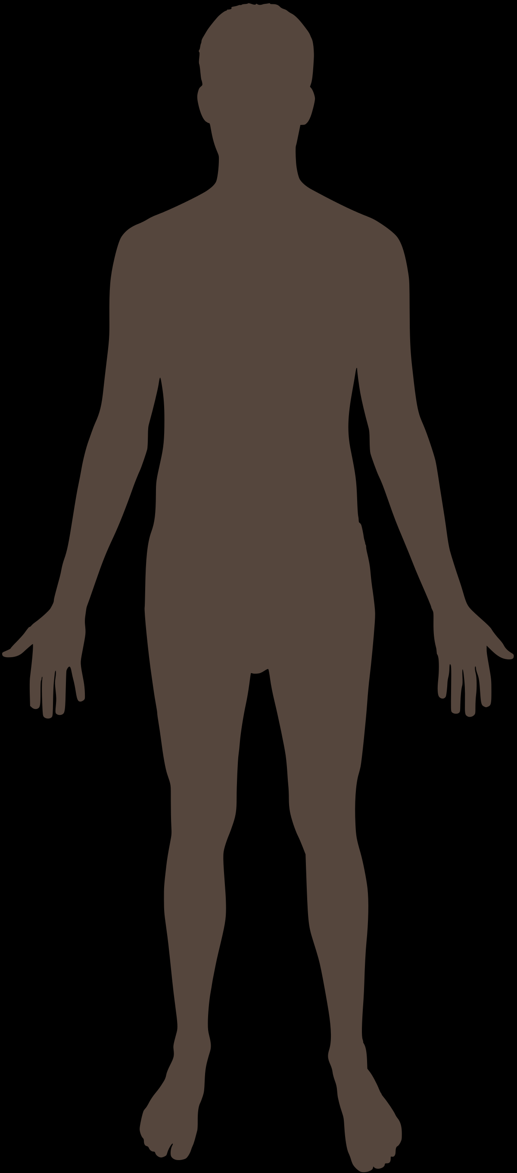
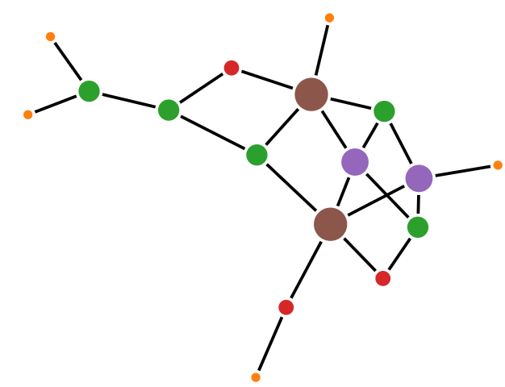


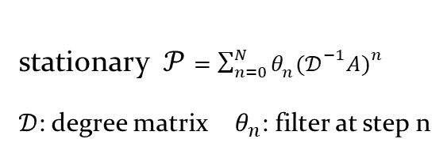
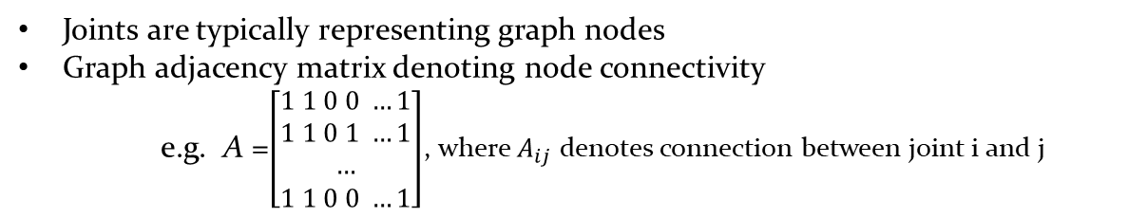

Preliminary
Graph representations for human skeleton
Graph diffusion convolution
Joints are typically representing graph nodes
Graph adjacency matrix denoting node connectivity
e.g. A =$\left[\begin{aligned}1 1 0 0 …1 \\ 1 1 0 1 …1 \\ … \\ 1 1 0 0 …1\end{aligned}\right]$, where $A_{ij}$ denotes connection between joint i and j
Limitation: only joints connected by bones are communicative
stationary $𝒫=\sum_{n=0}^{N}{θ_{n}{(𝒟^{−1}A)}^{n}}$
$𝒟$: degree matrix $θ_{n}$: filter at step n
  The diffusion process is represented by the weighted combination of random walk on graph.
  Locality & Globality: The polynomial combinations enables the massage passing within not only close neighbours but also high-order neighbours.
…
Limitation: diffusion along single direction restricts the flexibility of graph representation
$$n=0$$
$$n=1$$
$$n=2$$
Notes:
Undirected graph can not describe the diversity of information delivery between joint nodes.

Slide 7
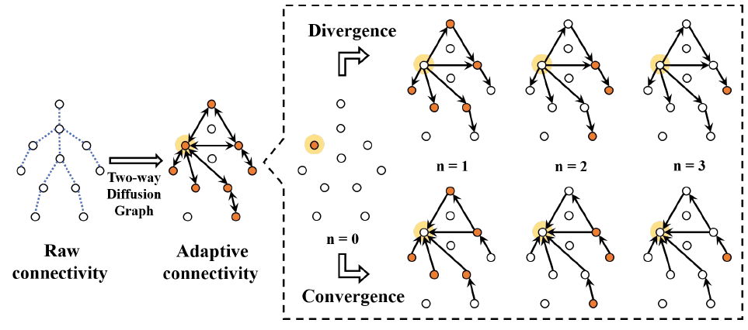
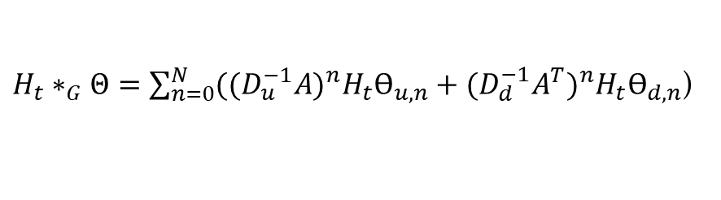


Bi-directional Spatial Formation
Our novelty in spatial design
  Adaptive graph → Any two joints are communicative without the constraints of bone connections.
  Bi-directional spatial diffusion → The joint movements are influenced by its upstream and downstream nodes under directed graph.
$$A=\left[\begin{aligned}1 1 0 0 …1 \\ 1 1 0 1 …1 \\ … \\ 1 1 0 0 …1\end{aligned}\right]$$
$$\left[\begin{aligned}w_{11}w_{12} w_{13} …w_{1J} \\ w_{21}w_{22} w_{23} …w_{2J} \\ … \\ w_{J1}w_{J2} w_{J3} …w_{JJ}\end{aligned}\right]$$
Two-way diffusion convolution operation for the input graph of joints $H$at frame t:
$H_{t}∗_{G}Θ=\sum_{n=0}^{N}{{((D_{u}^{−1}A)}^{n}H_{t}ϴ_{u,n}}+$ ${(D_{d}^{−1}A^{T})}^{n}H_{t}ϴ_{d,n}$)
divergence
convergence
Notes:
Undirected graph can not describe the diversity of information delivery between joint nodes.

Slide 8
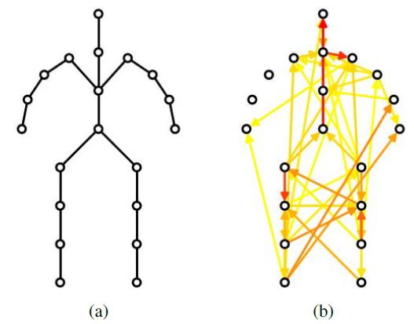
Bi-directional Spatial Formation
The learned informative connections
Key observations
  the importance of the implicit connections
  many selected connections between legs → walking-related motions are dominant
  more edges with the right arm than the left arm → most actors are likely right handed
fixed joint
connection
adaptive joint connection
The arrow denotes the direction of the connection.
The red color represents larger weights.

Slide 9

Bi-directional Temporal Construction
Two-way GRU predictor encode the forward and backward dynamics
Velocity-informed training → preserve short-term continuity of the predicted dynamics.
One-step temporal transition:
$$h_{t}={GRU}_{∗_{G}}(\left[{∇x}_{t}, h_{t−1}\right];w)$$
(${∇x}_{t}$: velocity between adjacent frames)
Bi-predictor → make the system observe its own generated dynamics from the past and the future.
Velocity-pose reconstruction loss:
$$L_{reconst}=\frac{1}{T−t}\left(\sum_{i=t+1}^{T}{{\left\|x_{i}−(x_{t}+\sum_{i^{′}=t+1}^{i}{{∇\hat{x}}_{i^{′}}})\right\|}_{2}^{2}+\sum_{j=1}^{T−t}{{\left\|x_{j}−(x_{T−t+1}−\sum_{j^{′}=j+1}^{T−t+1}{{∇\tilde{x}}_{j^{′}}})\right\|}_{2}^{2}}}\right)$$
“pose-aware” → control the pose-level generation
Forward predictor
Backward predictor
forward reconstructed pose
backward reconstructed pose

Slide 10



Bi-directional Temporal Construction
The forward and backward adversarial discriminator D
Forward discriminator (weights: $w_{f}$)
Backward discriminator (weights: $w_{b}$)
(weights: $w_{0}$)
Velocity-based adversarial loss: rectify both short-term and long-term dynamics → reduce motion drift.
Weight and structure sharing between predictor and discriminator in the same direction.
$L_{adv}=𝔼_{X}\log{D([{∇X}_{t+1:T},{∇X}_{T:t+1}]|w_{f},w_{b},w_{0})}$+ $𝔼_{\hat{X}}log⁡(1−D([{∇\hat{X}}_{t+1:T},{∇\hat{X}}_{T:t+1}]|w_{f},w_{b},w_{0})$

Slide 11
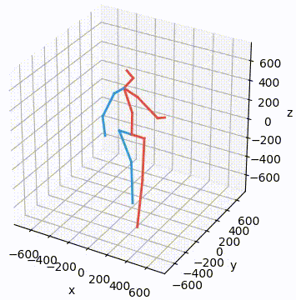
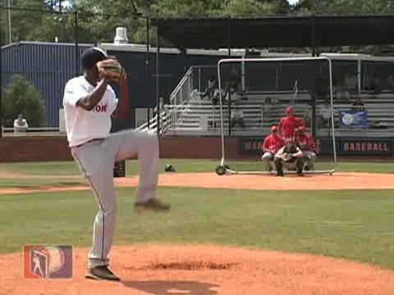
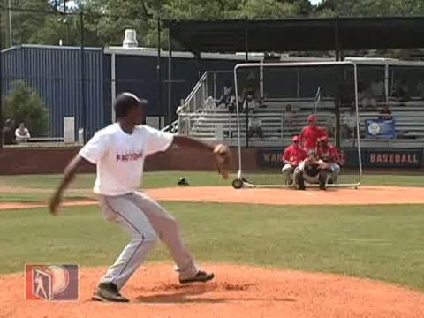
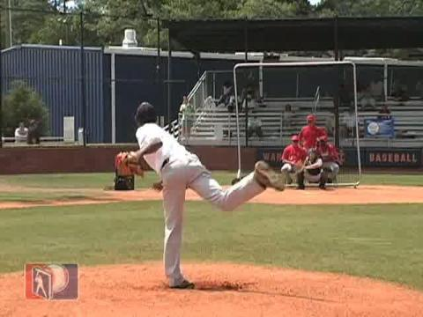
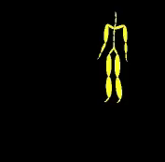
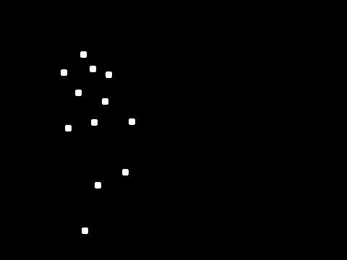
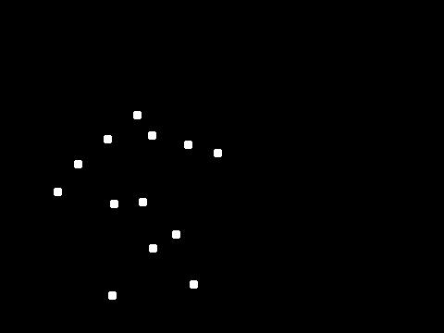
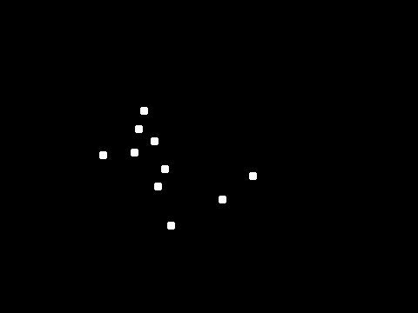
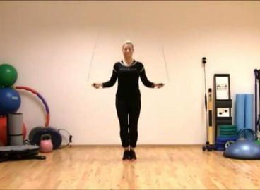
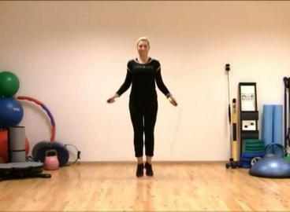
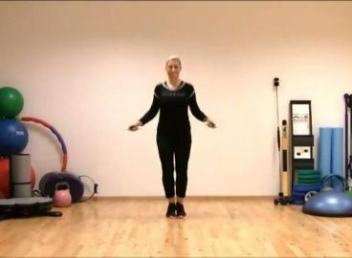
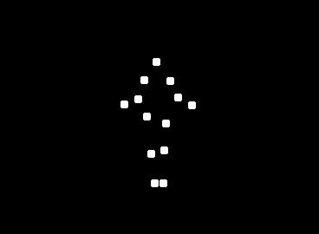
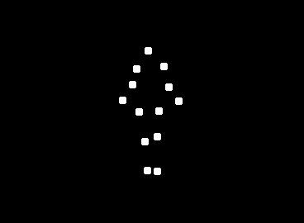
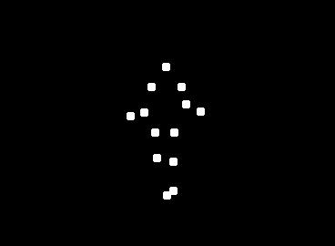
Datasets
Human3.6M
CMU Mocap
Penn Action (2D)

Slide 12
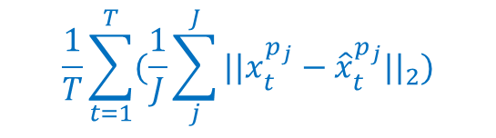
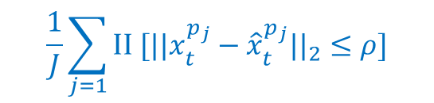

Experiments
Evaluation metrics
  MAE (mean angle error)
    sometimes not accurate, the same pose may have different Euler angular sets
  MPJPE (mean per joint position error)
    directly calculate the deviation of the estimated joint points
  PCK (percentage of corrected keypoint)
$$\frac{1}{T}\sum_{t=1}^{T}{{||x_{t}^{a}−{\hat{x}}_{t}^{a}||}_{2}}$$
$$\frac{1}{T}\sum_{t=1}^{T}{(\frac{1}{J}\sum_{j}^{J}{{||x_{t}^{p_{j}}−{\hat{x}}_{t}^{p_{j}}||}_{2})}}$$
$$\frac{1}{J}\sum_{j=1}{\text{II} [{||x_{t}^{p_{j}}−{\hat{x}}_{t}^{p_{j}}||}_{2}≤ρ]}$$
($x:$ Ground Truth, $\hat{x}$: Predicted Pose, $ρ$: threshold of radius, II: returns 1 if true, and 0 otherwise.)

Slide 13
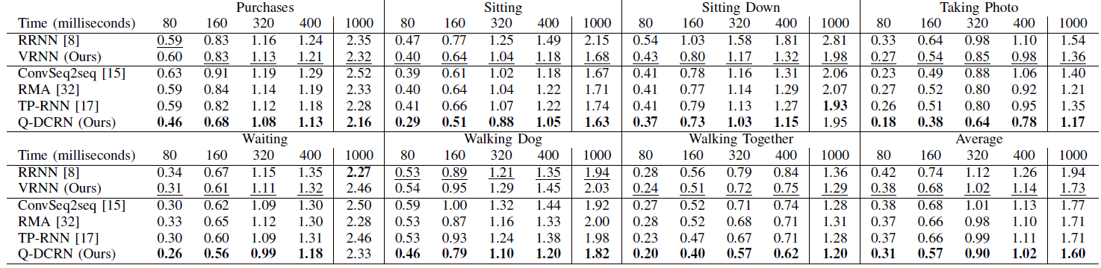
Experiments
Comparing with non-graph prediction models---Quantitative results
Q-DCRN achieves lower errors in both short and long-term predictions.

Slide 14
Experiments
Comparing with non-graph prediction models---Qualitative results
GT
RRNN
ConvSeq2seq
Q-DCRN
walking (high dynamic)
smoking (low dynamic)
Q-DCRN preserves both the high-dynamic or low-dynamic moving trends.

Slide 15
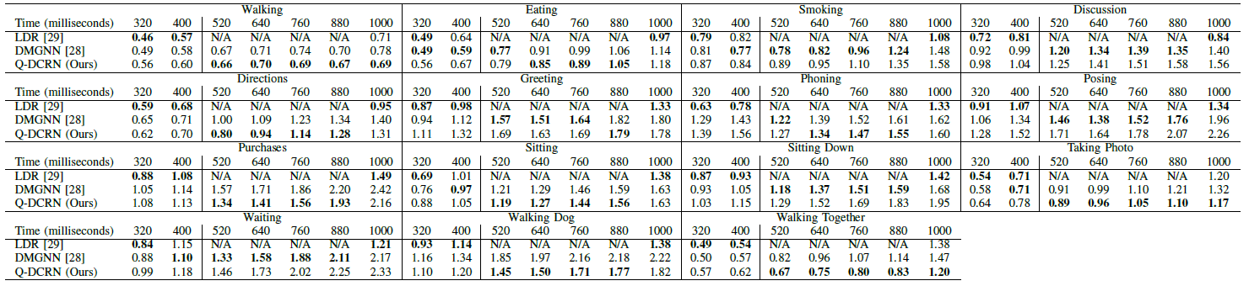
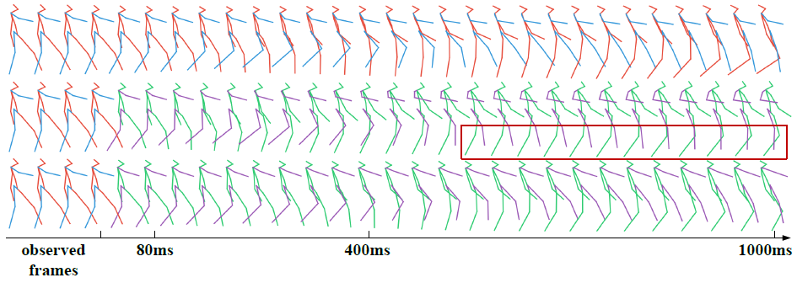
Experiments
Comparing with graph-based prediction models
Q-DCRN averagely performs better in the long-term prediction.

Slide 16
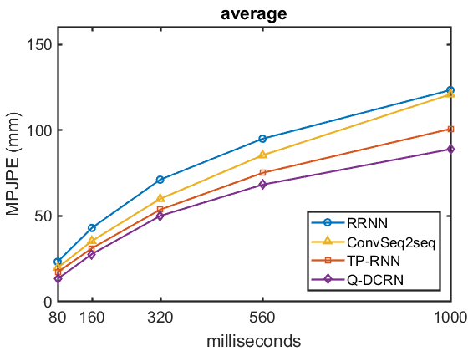
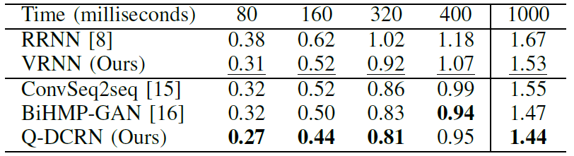
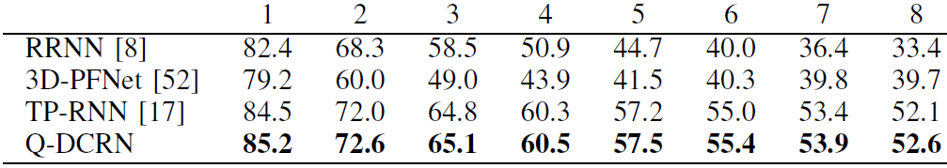
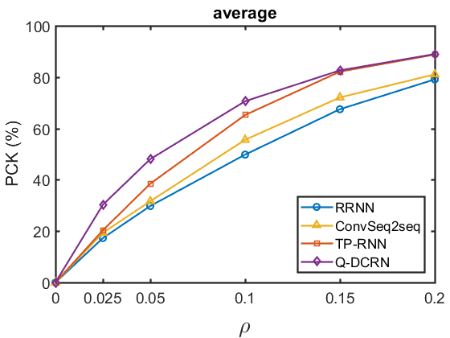
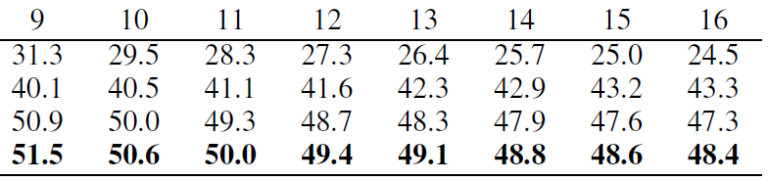
Experiments
Evaluation under MPJPE and PCK
Comparisons under CMU Mocap and Penn Action datasets
CMU Mocap (MAE)
MPJPE (↓ better)
Penn Action (PCK)
PCK (↑ better)

Slide 17
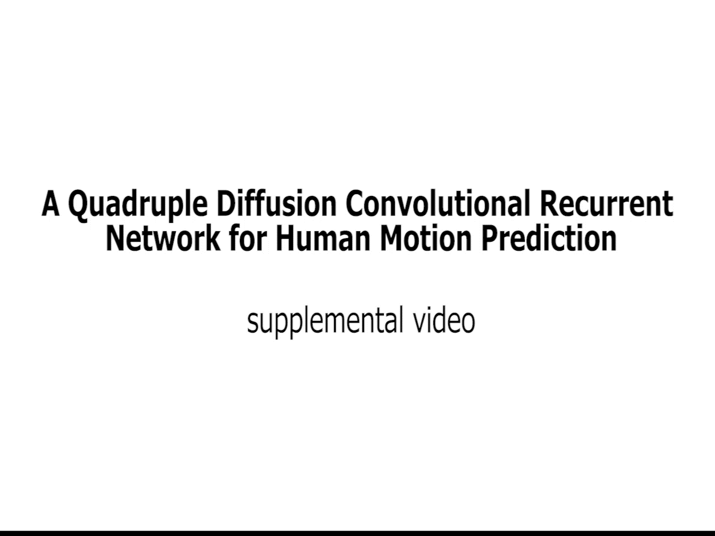
Experiments
More qualitative results

Slide 18
Conclusion
We propose a bi-directional diffusion graph under adaptive joint connectivity to mine the spatial interdependency for human motion prediction;
We propose to model velocity from the seed motion dynamics to reduce temporal discontinuity at early prediction meanwhile optimizing the restored poses to avoid unexpected generations;
We propose a bi-directional temporal predictor to reduce error accumulation from both past and future motion dynamics in an adversarial manner;
Quantitative results show that we achieve SOTAs prediction performance with various evaluation metrics under 3D and 2D motion data;
Qualitative results show that we can better preserve the moving trends in both high and low-dynamic motions.

