Slide 1
Semantics-STGCNN: A Semantics-guided Spatial-Temporal Graph Convolutional Network for Multi-class Trajectory Prediction
Ben A. Rainbow*, Qianhui Men†, and Hubert P. H. Shum*
* Department of Computer Science, Durham University
†Department of Computer Science, City University of Hong Kong

Slide 2
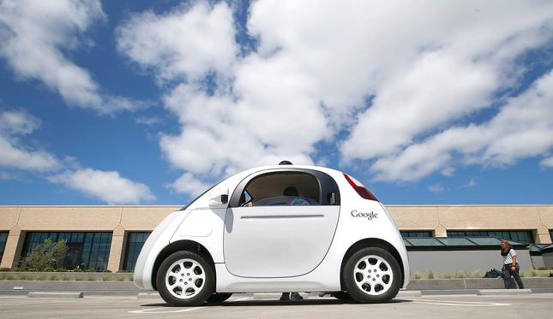
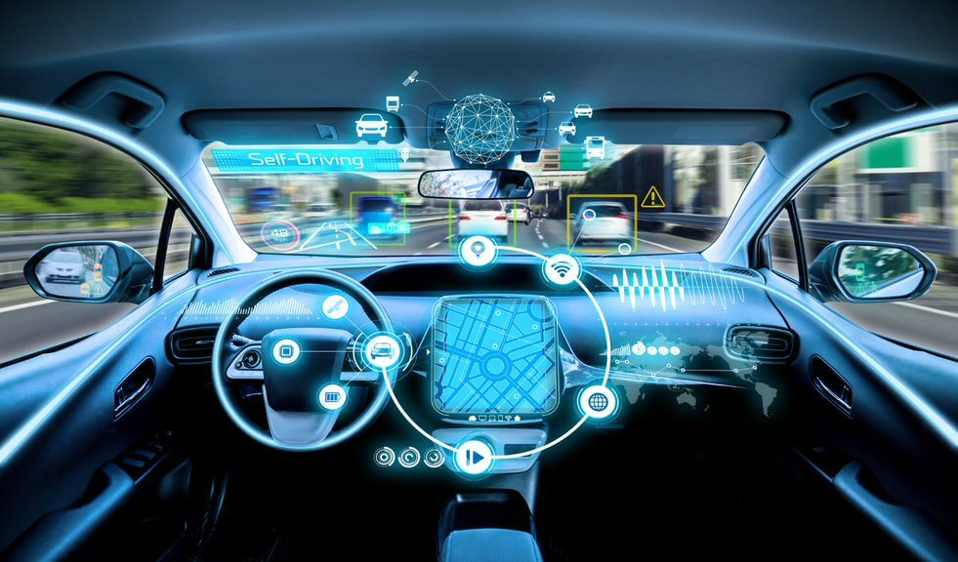
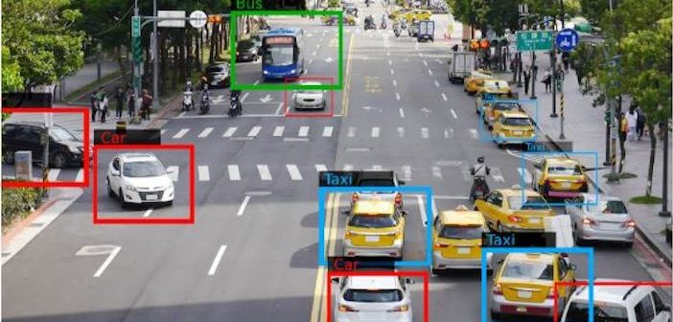
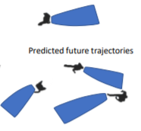
Introduction
Traffic trajectory prediction is critical in understanding behaviors
of pedestrians or cars
Traffic trajectory prediction is challenging
autonomous driving
surveillance systems
social interaction of the motion
large potentials in prediction
Semantics-STGCNN, B. A. Rainbow, Q. Men, and H. P. H. Shum

Slide 3
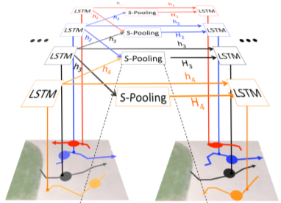
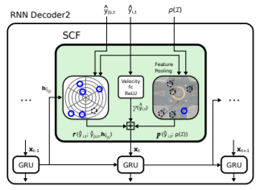
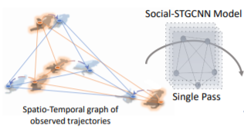
Related Work
Pooling layers
Recurrent architecture
Social Context Fusion
Spatial-temporal
graph convolution network
[Social-LSTM, CVPR’16]
[Social-STGCNN, CVPR’20]
[DESIRE, CVPR’17]
Semantics-STGCNN, B. A. Rainbow, Q. Men, and H. P. H. Shum

Slide 4
Motivation
Label information is essential to determine the future trajectory
Type of road users will influence the neighbour trajectories to be predicted
Truck
Pedestrian
Car
Car
Bike
Pedestrian
Semantics-STGCNN, B. A. Rainbow, Q. Men, and H. P. H. Shum

Slide 5
Methodology
Semantics-STGCNN: A Semantics-guided Spatial-Temporal Graph Convolutional Network for Multi-class Trajectory Prediction
Semantics-STGCNN, B. A. Rainbow, Q. Men, and H. P. H. Shum

Slide 6
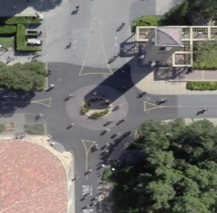
Methodology
Semantic-guided graph structure
Velocity-based adjacency matrix (VAM)
Label adjacency matrix (LAM)
$$A_{t}^{v}\left(i,j\right)=\left\{\begin{aligned}\frac{1}{{||v_{t}^{i}−v_{t}^{j}||}^{2}}， if{ ||v_{t}^{i}−v_{t}^{j}||}^{2}≠0 \\ 0， otherwise\end{aligned}\right.$$
Objects that are further away are less likely to have an impact on the trajectory.
The semantic correlation is learned from
the identities of the label pairs.
repeat
$$N×C$$
one-hot
$$N×N×T_{obs}$$
Object label:
car, biker, pedestrian, skater, …
⨁
FC
LAM
$$C×N$$
Label Adjacency Matrix
repeat
Semantics-STGCNN, B. A. Rainbow, Q. Men, and H. P. H. Shum

Slide 7
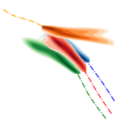
Methodology
ST-GCNN
Evaluation Metrics
VAM
$$N×N×T_{obs}$$
⨁
FC
SAM
Semantic-guided
Adjacency Matrix
LAM
Predicted
distribution
ST-GCNN
TXP-CNN
Minimum Average/Final
Displacement Error
Average² Displacement Error
& Average Final Displacement Error
Semantics-STGCNN, B. A. Rainbow, Q. Men, and H. P. H. Shum

Slide 8
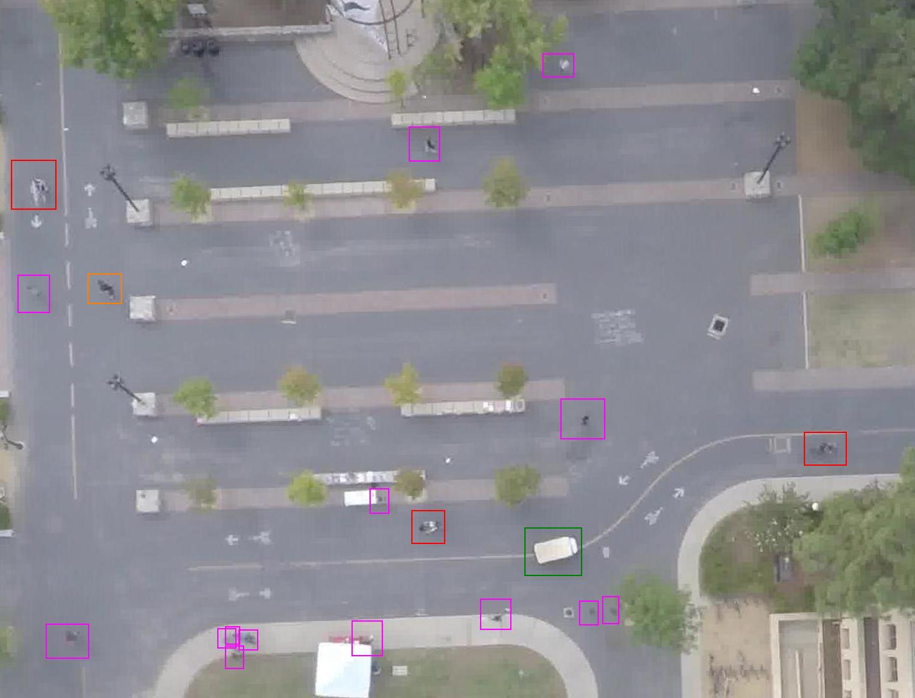
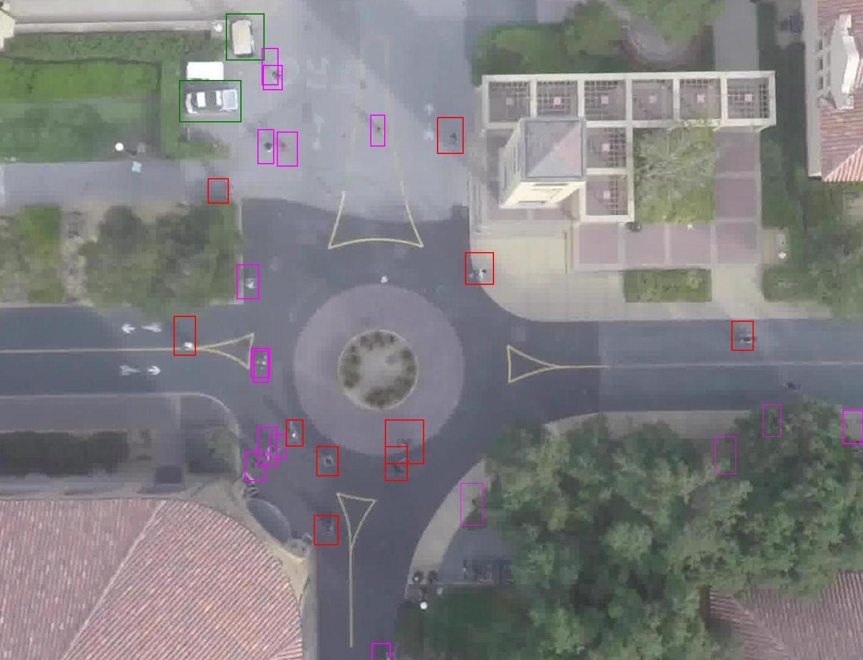
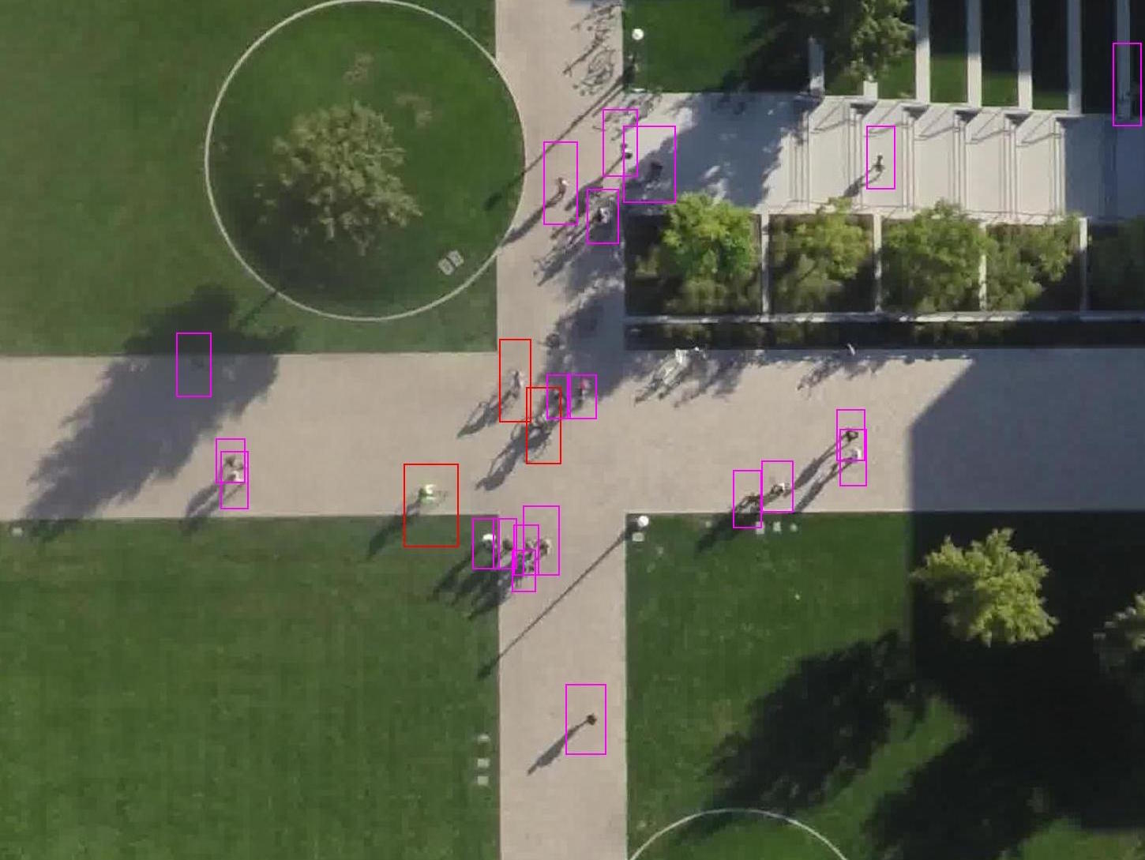
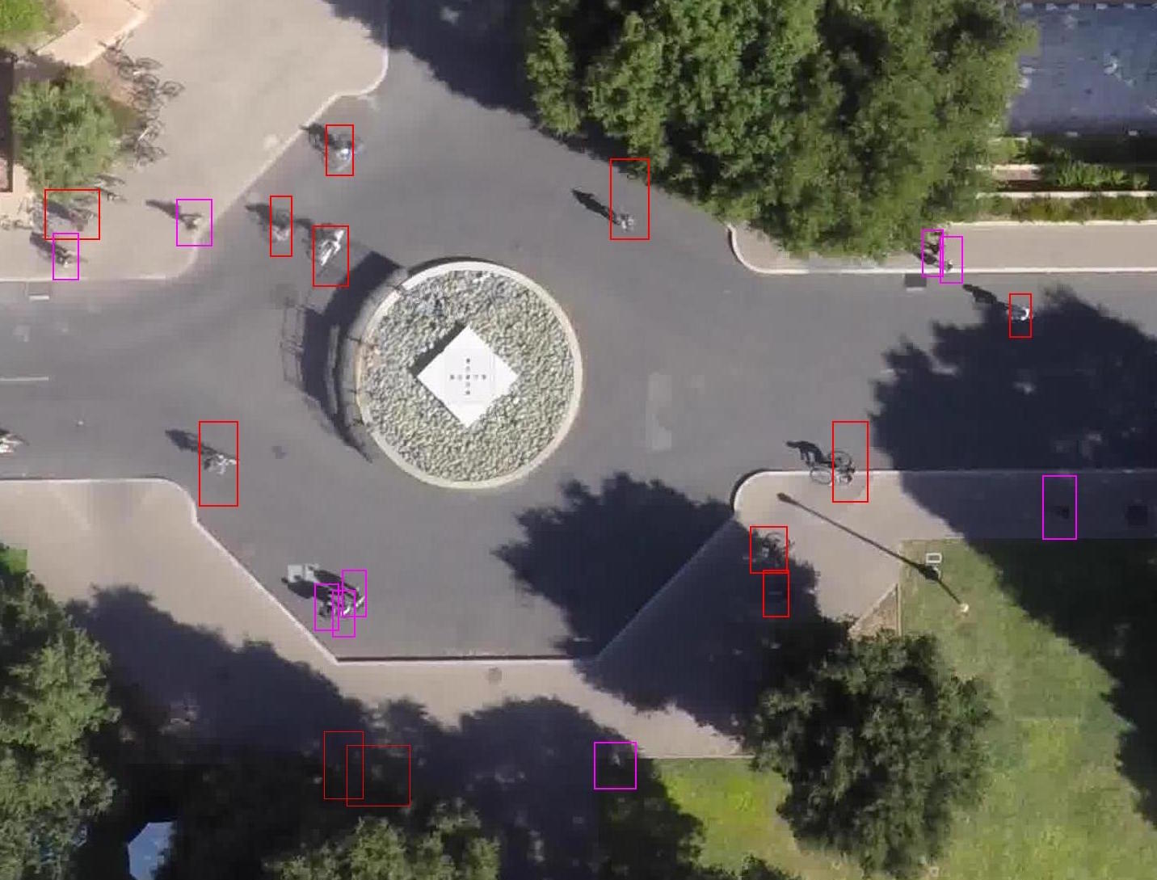
Experiments
Dataset
Six classes of trajectories: pedestrians, bicyclists, skateboarders, cars, buses, carts
Top views captured by drones
Train on 8 frames and test on the next 12 frames: randomly sample 20 trajectories (K=20)
Stanford Drone Dataset (SDD)
Semantics-STGCNN, B. A. Rainbow, Q. Men, and H. P. H. Shum

Slide 9
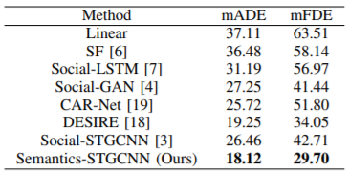
Experiments
Quantitative Evaluation
Semantic-STGCNN is robust under different evaluation metrics.
Semantic-STGCNN performs the best against SOTA.
Items being faster-moving, i.e. Car, Bus, and Skater, are more affected by the classes of the objects.
Semantics-STGCNN, B. A. Rainbow, Q. Men, and H. P. H. Shum

Slide 10
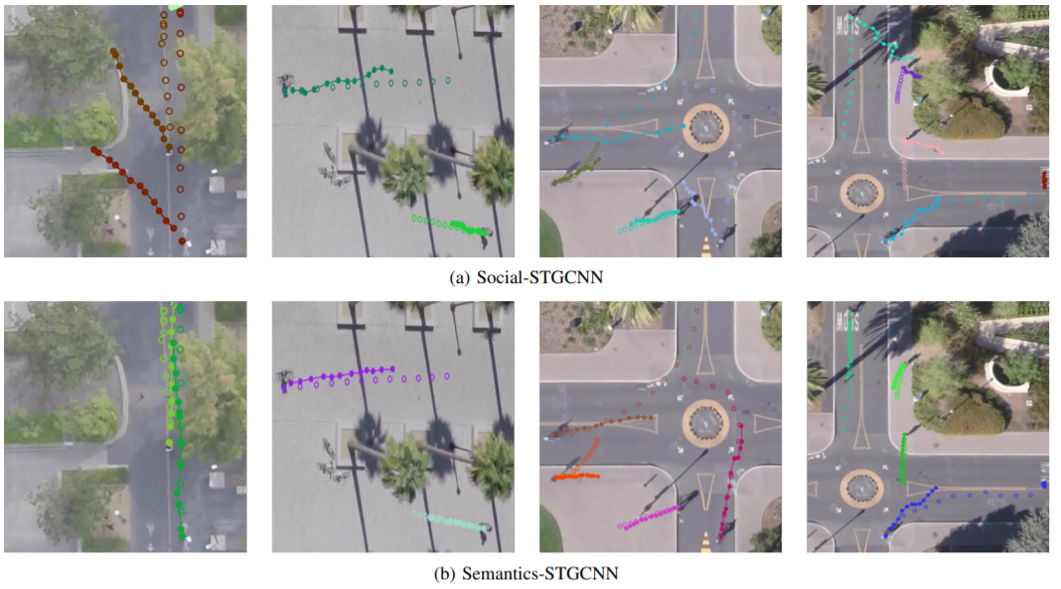
Experiments
Qualitative Evaluation
Semantics-STGCNN, B. A. Rainbow, Q. Men, and H. P. H. Shum

Slide 11
Experiments
Qualitative Evaluation
Semantics-STGCNN, B. A. Rainbow, Q. Men, and H. P. H. Shum

Slide 12
Summary
We propose Semantics-STGCNN, a semantics-guided spatial-temporal graph convolution network for multiclass trajectory prediction.
Core to the network is the construction of a label-aware adjacency matrix that is informed by the semantics of the trajectory data based on the embedded class labels.
State-of-the-art prediction performance on multi-class trajectory dataset under various metrics. Can be easily extended to static objects (e.g., trees, roads) as high-level labels.
Semantics-STGCNN, B. A. Rainbow, Q. Men, and H. P. H. Shum

Slide 13
Thank you for watching!
Code: https://github.com/Yutasq/Multi-Class-Social-STGCNN
Questions / Comments please contact: qianhumen2-c@my.cityu.edu.hk

