Slide 1
Interaction Patches for Multi-Character Animation
Hubert P. H. Shum
Taku Komura
Masashi Shiraishi
Shuntaro Yamazaki

Slide 2
Multi-Character Interaction

Slide 3
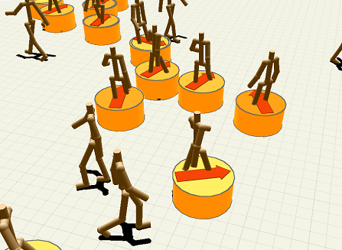
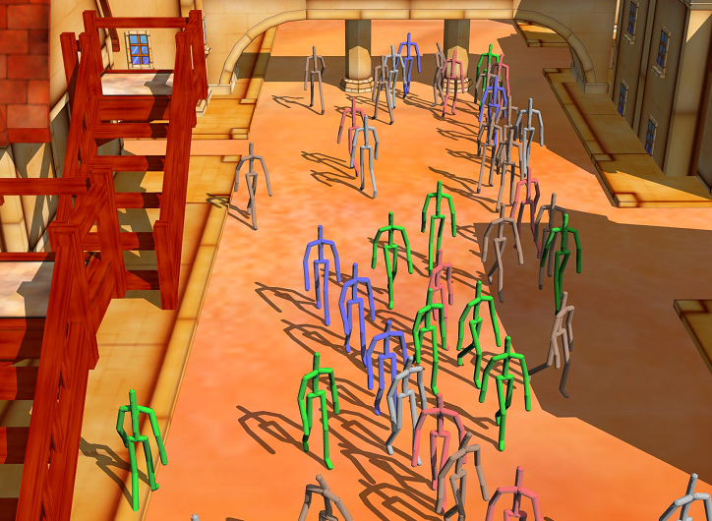
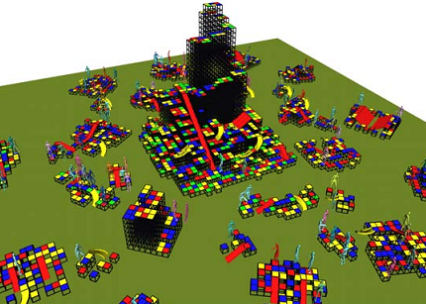
Crowd Simulation
Plan the motions of multiple characters moving in a given environment
Cannot handle dense interactions among the characters
Treuille et al. 2007 Near-Optimal Character Animation with Continuous Control
Kwon et al. 2008 Group Motion Editing
Lee et al. 2007 Motion Patches

Slide 4
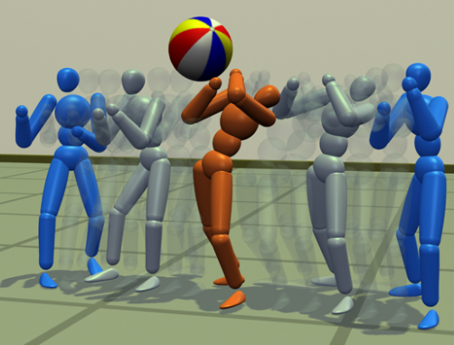
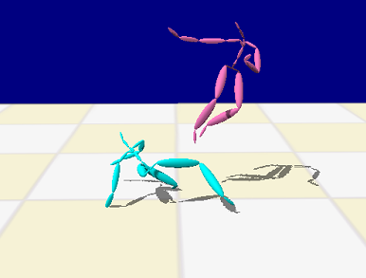
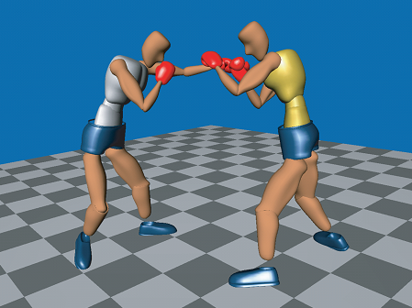
Interaction Simulation
Simluate interactions between two characters
Cannot handle many-to-many interactions
Zordan et al. 2007 Anticipation from Example
Park et al. 2004 Analysis and Synthesis of Interactive Two-Character Motions
Lee et al. 2006 Precomputing Avatar Behavior from Human Motion Data

Slide 5
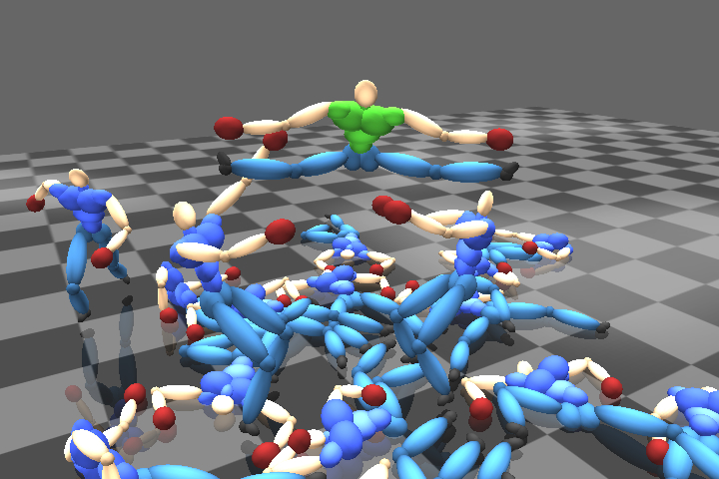
Dense Interaction Among Multiple Characters
Realistic dense interaction
Many to many interaction

Slide 6
System Overview
Single Person Mocap
Interaction Patches
Concatenating Interaction Patches
Final Animation
Kick
Fall
Avoid
Punch

Slide 7
Actions: Minimal Units of Movement
Punch
Kick
Avoid
Fall

Slide 8
Pattern Lists
Define the way the two characters interact
List the required types of actions to be performed by the two characters
Ch1: Punch Ch2: Avoid Ch2: Kick Ch1: Avoid

Slide 9
Game Tree Expansion
Punch
Ch1: Punch Ch2: Avoid Ch2: Kick Ch1: Avoid
Avoid
Kick
Avoid
Shum et al. 2007

Slide 10
Interaction Patches
Expanded Game Tree
Interaction Patches
Punch
Ch. 1
Punch
Avoid
Avoid
Ch. 2
Avoid
Kick
Kick
Avoid
Time

Slide 11
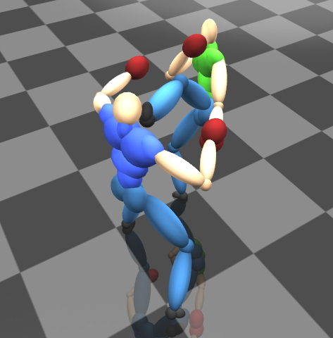
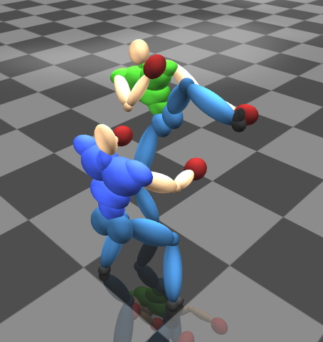
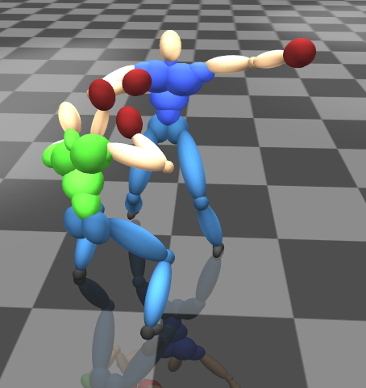
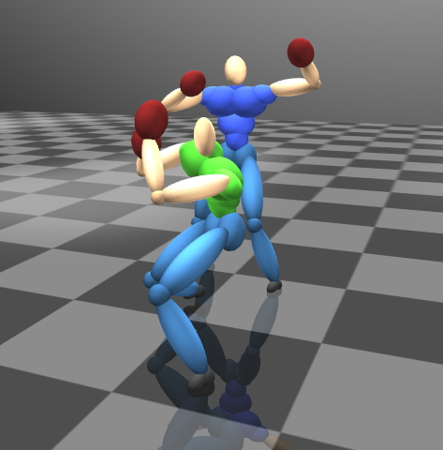
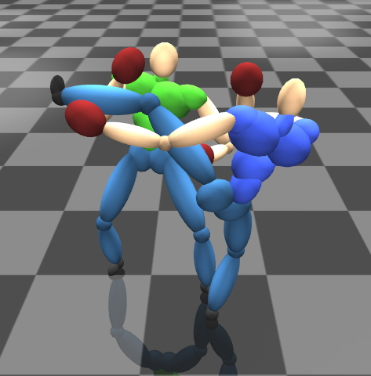
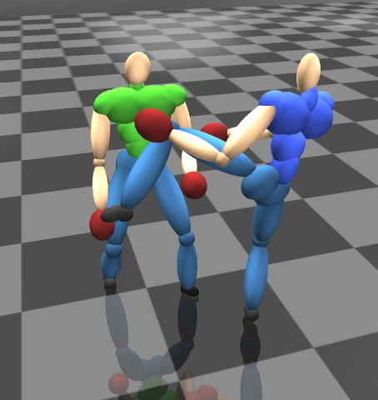
The Quality of Interation
Contacts
Distance and orientation
Timing

Slide 12
Examples of Interaction Patches
Punch
Fall
Kick
Fall
Punch
Avoid
Punch
Fall
Kick
Dodge
Punch
Fall

Slide 13
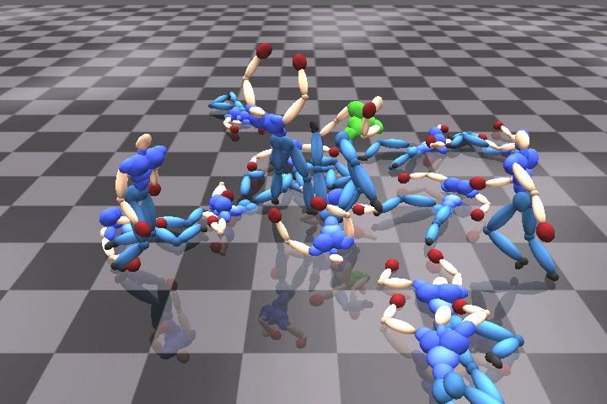
Concatening Interaction Patches
Kick
Fall
Avoid
Punch
Kick
Fall
Avoid
Punch
Kick

Slide 14
Temporal Concatenation
Ch. 2
Kick
Fall
Ch. 1
Dodge
Kick
Ch. 1
Avoid
Punch
Ch. 3
Kick
Fall
Time
Ch. 2
Kick
Avoid
Ch. 2
Dodge
Kick
Ch. 1
Avoid
Punch
Ch. 1
Kick
Avoid
Time

Slide 15
Temporal Concatenation

Slide 16
Spatial Concatenation
Ch. 2
Kick
Fall
Ch. 1
Punch
Kick
Ch. 1
Avoid
Punch
Ch. 3
Kick
Fall
Time
Ch. 2
Kick
Dodge
Fall
Ch. 1
Punch
Kick
Ch. 1
Avoid
Punch
Kick
Walk
Ch. 3
Kick
Fall
Time

Slide 17
Spatial Concatenation

Slide 18
Generating the Final Animations
Ch. 2
Ch. 5
Ch. 1
Ch. 3
Ch. 6
Ch. 4
Time

Slide 19
Generating the Final Animations
Ch. 5
Ch. 3
Ch. 1
Ch. 2
Ch. 4
Time

Slide 20
Visualizing Interaction Patches

Slide 21
Result: American Football

Slide 22
Result: Continuous Fighting

Slide 23
Result: Avoiding a Mouse

Slide 24
Result: Moving Luggage

Slide 25
Result: User Control Interface

Slide 26
Result: Crowd Falling

Slide 27
Disscussion
Small number of interaction patches
Easier to maintain quality
Less memory required
User designed pattern list
Large degree of freedom
Difficult for abstract and aimless actions
Not yet available in game
Controllability
Scene organization strategy

Slide 28
Conclusion
Generate a crowd of characters interacting with one another
Precompute interactions of two characters ➔ Interaction patches
Concatenate interaction patches to generate a large scene

Slide 29
Acknowledgements
We would like to thank Prof. Shigeo Morishima in Waseda University for providing kind supports
This project was supported by RIKEN, the Research Grant Council of Hong Kong, and the Ministry of Education, Culture, Sports, Science and Technology of Japan

Slide 30
Thanks!
Any Questions and Suggestions?

