Slide 1
DSPP: Deep Shape and Pose Priors of Humans
Shanfeng Hu
shanfeng.hu@northumbria.ac.uk
Department of Computer and
Information Sciences
Northumbria University
Newcastle upon Tyne, UK
Hubert P. H. Shum∗
hubert.shum@northumbria.ac.uk
Department of Computer and
Information Sciences
Northumbria University
Newcastle upon Tyne, UK
Antonio Mucherino
antonio.mucherino@irisa.fr
IRISA
University of Rennes 1
Rennes, France

Slide 2
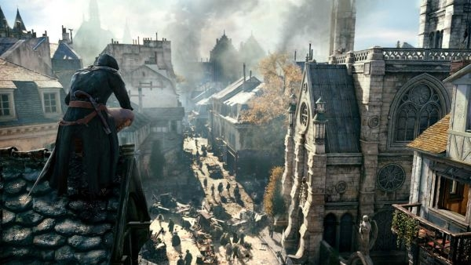
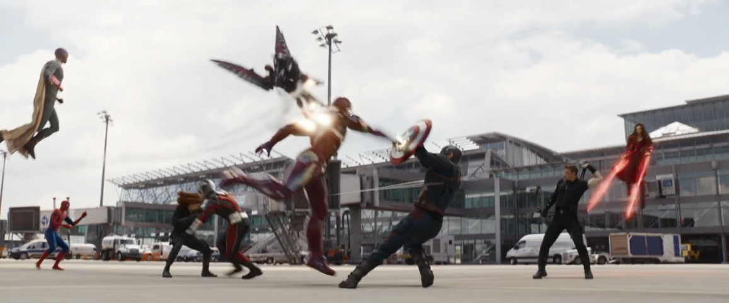
Background and Motivation
3D virtual humans are essential in computer animations and games
However, scanning and capturing real humans are costly
Automatically synthesizing high-quality human shapes and poses becomes essential

Slide 3
Related Work
Linear Subspace Methods: [Blanz et al. 1999; Allen et al. 2003; Anguelov et al. 2005; Loper et al. 2015]
  Assuming that the distributions of human shapes and poses are globally supported on a linear subspace
    E.g. Using PCA to model the subspace
  May generate unrealistic humans in low-probability area
Deep Learning Methods: [Habibie et al. 2017; Chen et al. 2017; Tan et al. 2018; Gokaslan et al. 2018; Kanazawa et al. 2018]
  Learning the non-linear manifold of human shapes and poses
    E.g. Variational Autoencoders (VAEs), Generative Adversarial Networks (GANs)
  Directly sampling from the distribution to consistently create high-quality random samples
Notes:
Previous works can be classified into two categories.

Slide 4
Our Main Idea
Auto-encoding human shapes and poses into a low-dimensional space
Learning the manifold of human shapes and poses using GANs in this space
Known as Adversarial Autoencoders (Makhzani et al. 2016) traditionally used in image/video analysis
  Instead of learning directly in the geometry (input/output) space as in previous work, our method learns in the low dimensional hidden (middle layers) space

Slide 5
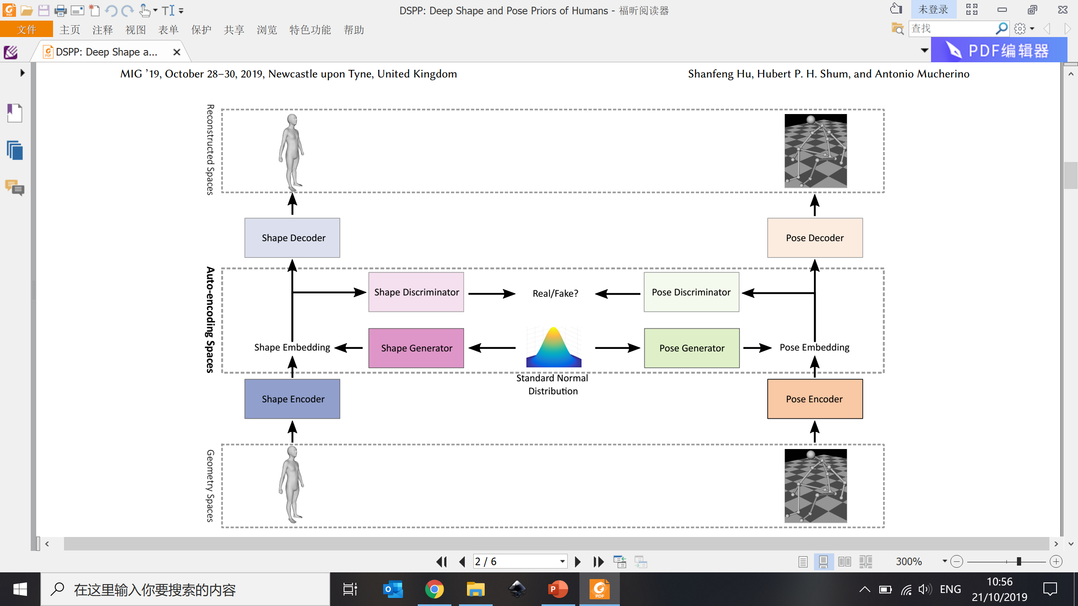
System Framework – Shape Autoencoder
Geometry Space
(Reconstructed)
Shape Decoder
Low Dimensional
Auto-encoder Space
Shape Embedding
Shape Encoder
Geometry Space
(Input)

Slide 6
System Framework – Shape GAN
Geometry Space
(Reconstructed)
Shape Decoder
Shape Discriminator
Real/
Fake?
Low Dimensional
Auto-encoder Space
Shape Generator
Shape Embedding
Standard Normal Distribution
Shape Encoder
Geometry Space
(Input)

Slide 7
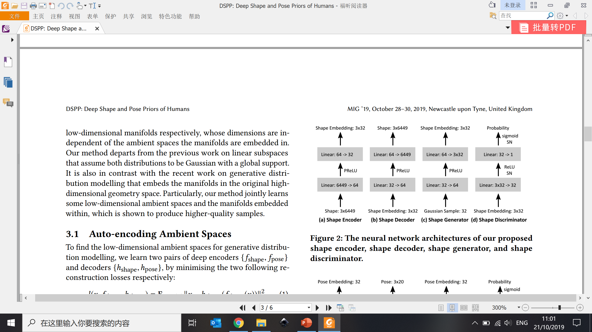
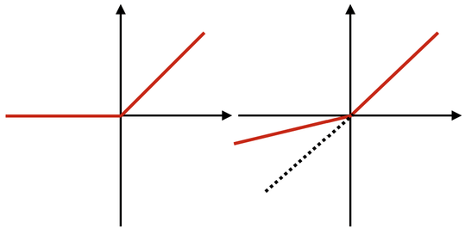
System Framework – Network Architecture
Shape Decoder
SN: Spectral Normalization
Guaranteeing the discriminator to be a smooth function
Much easier to train
Shape Discriminator
Real/
Fake?
Shape Generator
Shape Embedding
ReLU -
Rectified Linear Unit
PReLU -
Parametric Rectified Linear Unit
Standard Normal Distribution
Shape Encoder
Notes:
128/64/32 low dimensional space does not differ much
SN Has to be used for all layers such that the whole network becoming a smooth function

Slide 8
System Framework – Pose Autoencoder
Geometry Space
(Reconstructed)
Shape Decoder
Pose Decoder
Shape Discriminator
Real/
Fake?
Low Dimensional
Auto-encoder Space
Shape Generator
Shape Embedding
Pose Embedding
Standard Normal Distribution
Shape Encoder
Pose Encoder
Geometry Space
(Input)

Slide 9
System Framework – Pose GAN
Geometry Space
(Reconstructed)
Shape Decoder
Pose Decoder
Shape Discriminator
Real/
Fake?
Pose Discriminator
Low Dimensional
Auto-encoder Space
Shape Generator
Pose Generator
Shape Embedding
Pose Embedding
Standard Normal Distribution
Shape Encoder
Pose Encoder
Geometry Space
(Input)

Slide 10
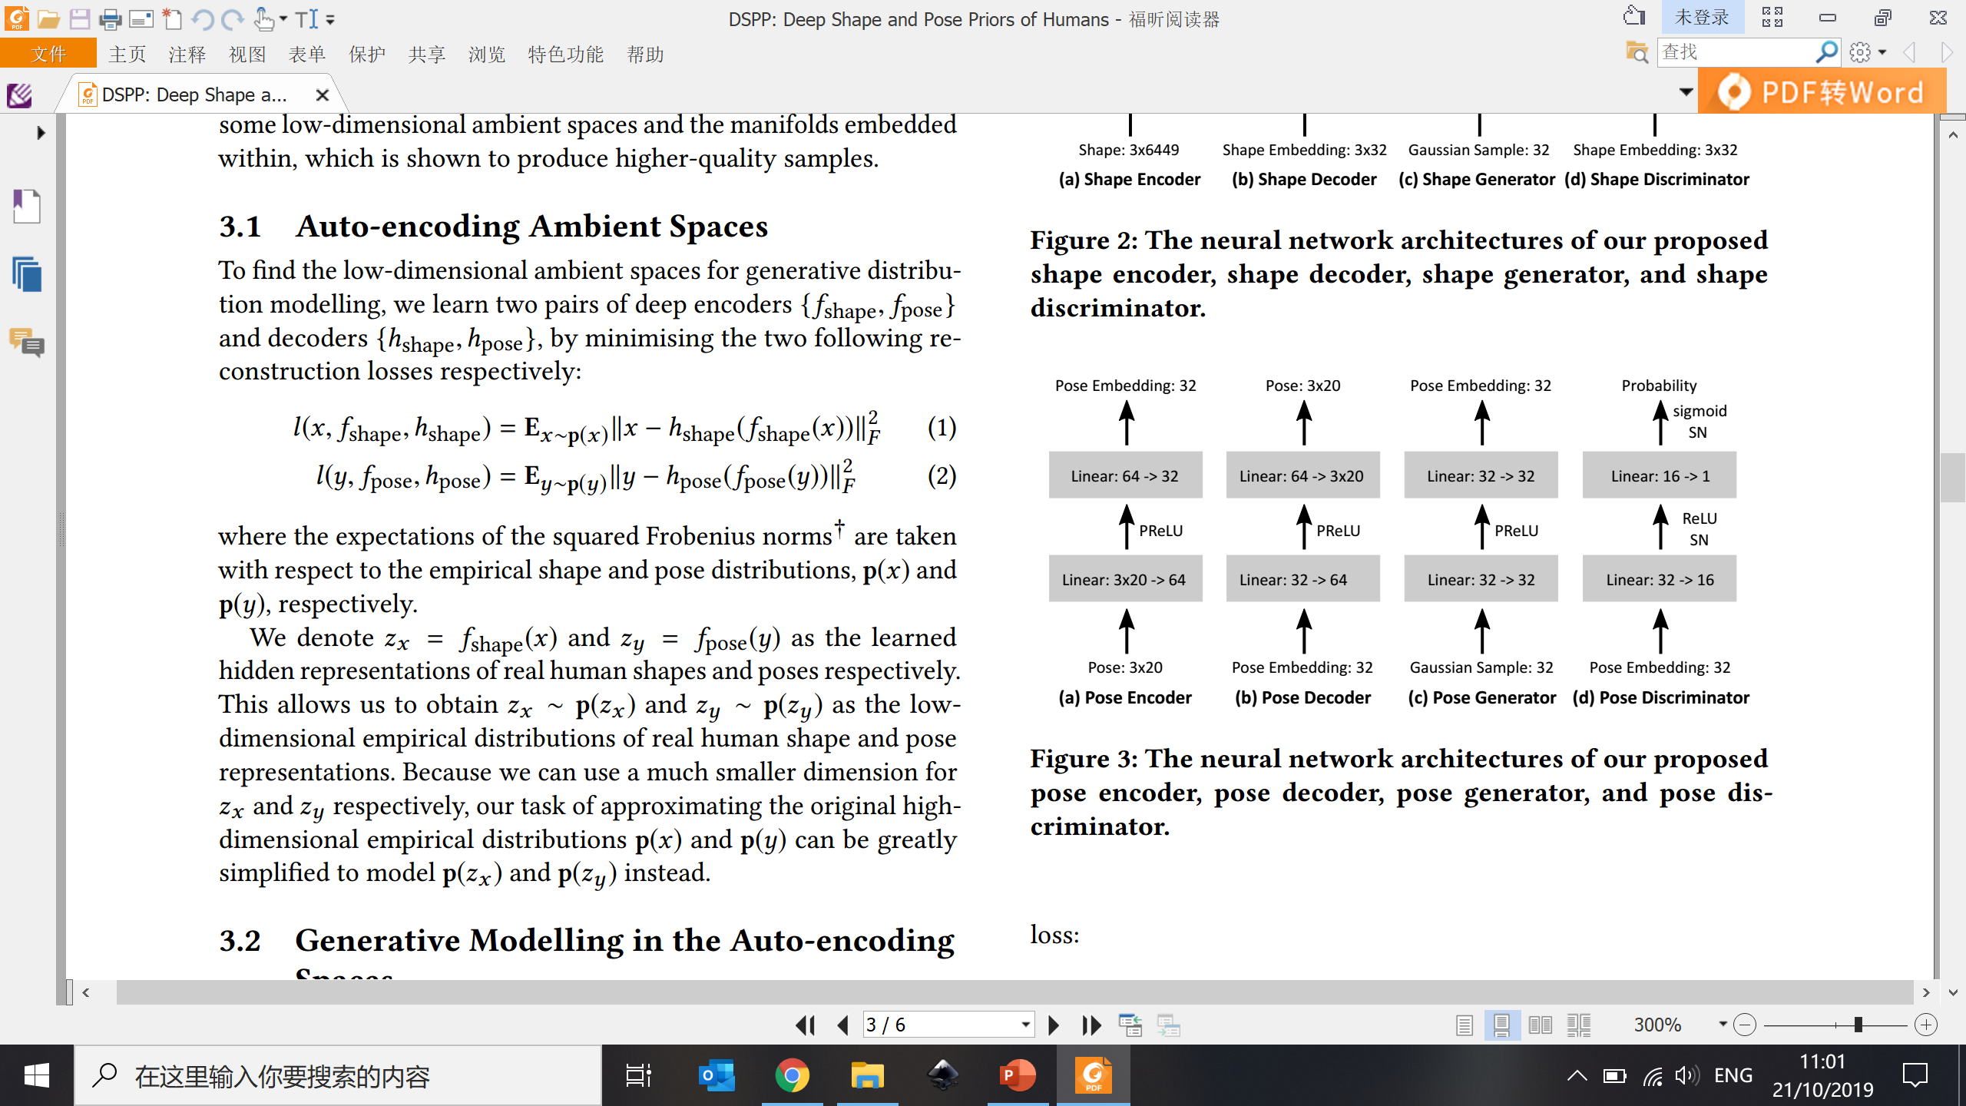
System Framework – Network Architecture
Pose Decoder
Real/
Fake?
Pose Discriminator
Pose Generator
Pose Embedding
Standard Normal Distribution
Pose Encoder
Notes:
Do not consider global rotation/translation of the hip joint

Slide 11
Training Datasets
MPII Human Shape Dataset [Pishchulin et al. 2017]
  4,308 human shapes
  6,449 vertices for each shape
SFU Motion Capture Dataset [SFU 2016]
  100,000 human poses, covering walking, running, dancing, and interactions
  Each pose is represented using the 3D Euler angles of 20 joints excluding the hips joint
Notes:
Standardized (the same) bone length for all poses

Slide 12
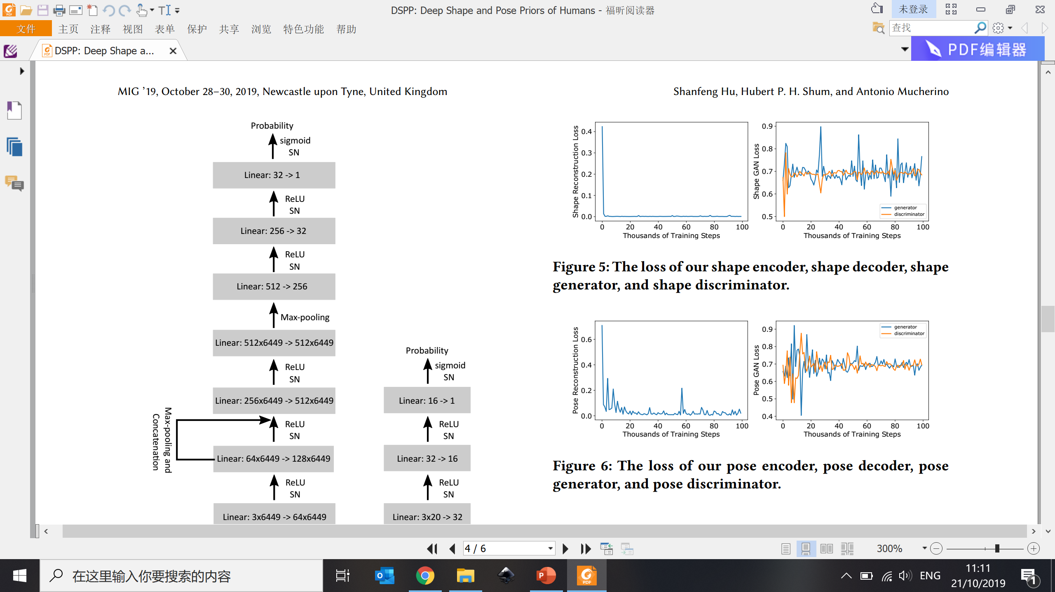
Results – Training Losses
Consistent loss reduction
Easy to compress shape/pose into low dimensional without much loss
The generator and the discriminator keeping on completing
No spiky loss
No one-side winning
Shape Reconstruction Loss (left) and GAN Loss (right)
Pose Reconstruction Loss (left) and GAN Loss (right)
Notes:
From the reconstruction loss, it shows that it is easy to compress the shape/pose into low dimensional without much loss
GAN loss – well-behaving as the generator and discriminator keeps on completing with each other (no very spiky loss, no one side winning)

Slide 13
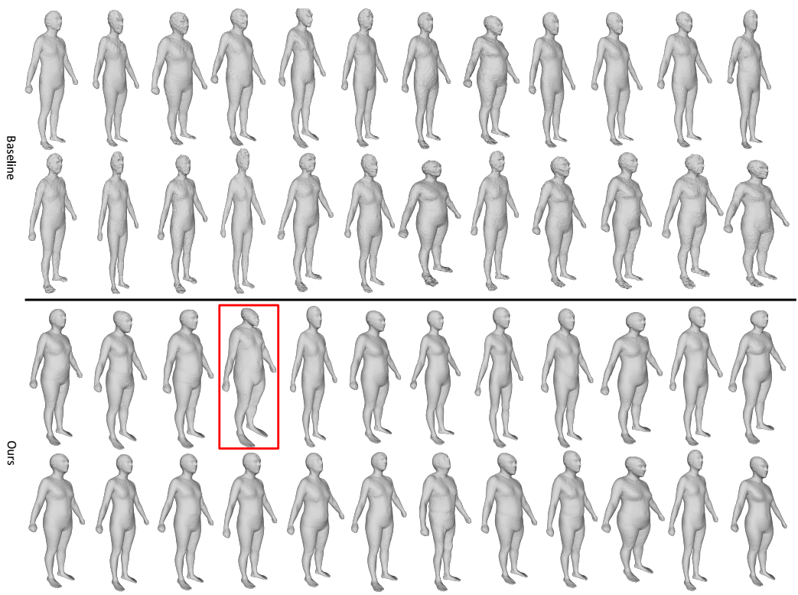
Results – Human Shape Samples
Baseline: GAN in the geometry space
Ours: GAN in the low-dimensional embedded space
Notes:
Random Gaussian sampling for the generator

Slide 14
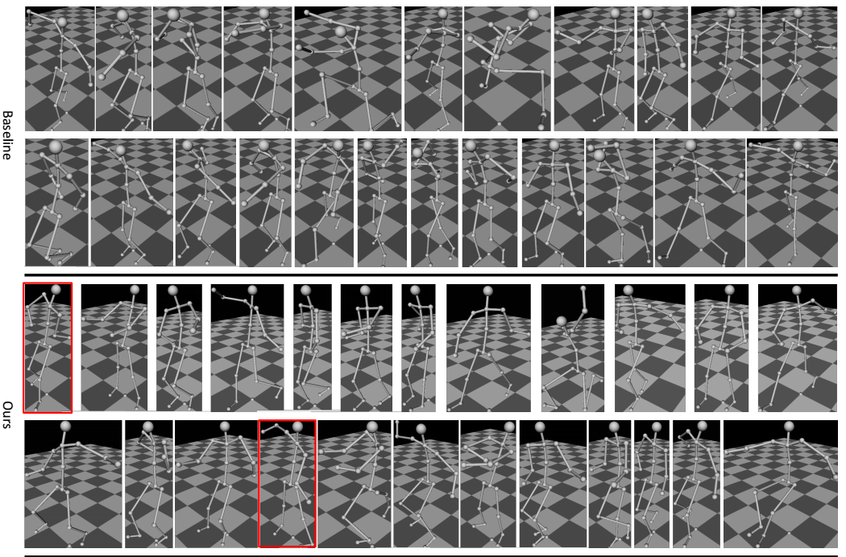
Results – Human Pose Samples
Baseline: GAN in the geometry space
Ours: GAN in the low-dimensional embedded space

Slide 15
Conclusion and Future Work
We proposed to learn the manifold of human shapes and poses using GANs in the low-dimensional auto-encoding space
We open the source code and dataset
Future work
  Joint modelling of distributions for both shape and pose
    Correlating the bone length between shape and pose
    Deforming the generated human shapes using the generated human poses
  Quantitative metric to evaluate the realism of generated human samples (e.g. deep classifier to get a score)

Slide 16
Thanks!
Any questions?

Slide 17
System Framework
Geometry Space
(Reconstructed)
Shape Decoder
Pose Decoder
Shape Discriminator
Real/
Fake?
Pose Discriminator
Low Dimensional
Auto-encoder Space
Shape Generator
Pose Generator
Shape Embedding
Pose Embedding
Standard Normal Distribution
Shape Encoder
Pose Encoder
Geometry Space
(Input)

Slide 18
Overview
Background and Motivation
Related Work
Our Methodology
Results
Conclusion and Future Work

Slide 19
System Framework
Notes:
Distribution is currently not correlated between shape and pose

Slide 20
Network Architectures
Shape Network Architectures
Pose Network Architectures
Notes:
PReLU: Parametric Rectifier Linear Unit
ReLU vs PReLU https://miro.medium.com/max/1310/1*avswi5XZlGlYx4wqdzo_Xg.png
(easier to learn)
SN (Spectral Normalization) – when used together you guarantee the discriminator is a smooth function and is much easier to train. SN has to be used for all layers to ensure that the whole network forms a smooth function.
128/64/32 low dimensional space does not differ much

