Slide 1
Fast Accelerometer-Based Motion Recognition with a Dual Buffer Framework
Hubert P. H. Shum University of Worcester
Taku Komura University of Edinburgh
Shu Takagi
RIKEN Japan

Slide 2
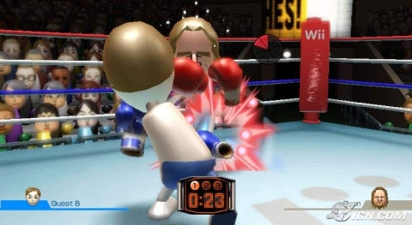
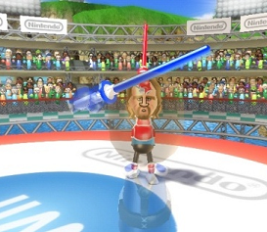
Games using Accelerometer-Based Controller - Huge Demand but Unsatisfying Quality

Slide 3
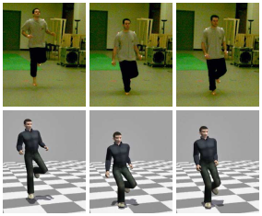
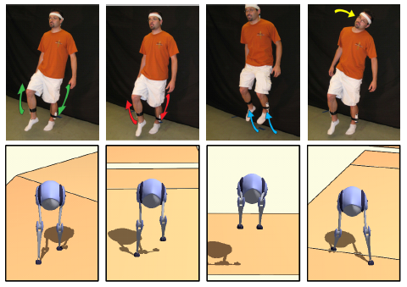
Controlling Virtual Character - Low Dimensional Controller, Variety of Motion, Control Accuracy
Chai et. al. 2005 Performance Animation from Low-dimensional Control Signals
Shiratori et. al. 2008 Accelerometer-based User Interfaces for the Control of a Physically Simulated Character
McCann et. al. 2007 Responsive Characters from Motion Fragments

Slide 4
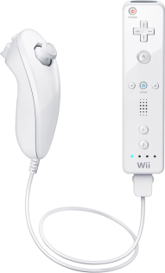
System Overview - Use Wiimote for Control Signals
Interaction Graph
Action Level Motion Graph
Control Signals for Controllable Actions
Control Signals from Accelerometers

Slide 5
Action Level Motion Graph - Reorder Captured Motion to General New Motion
Punch
Dodge
Avoid
Walk
Kick
Avoid
Avoid
Punch
Walk
Punch
Walk
Kick
Dodge
Kick
Dodge

Slide 6
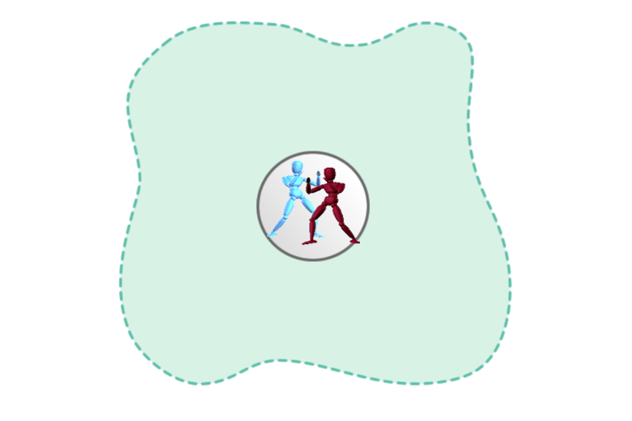
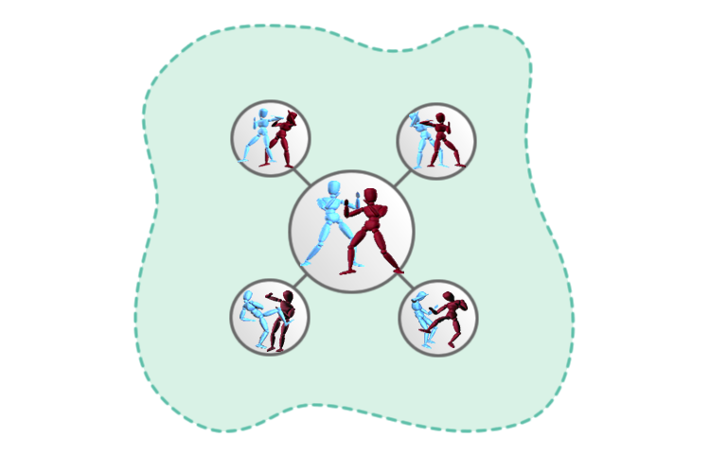
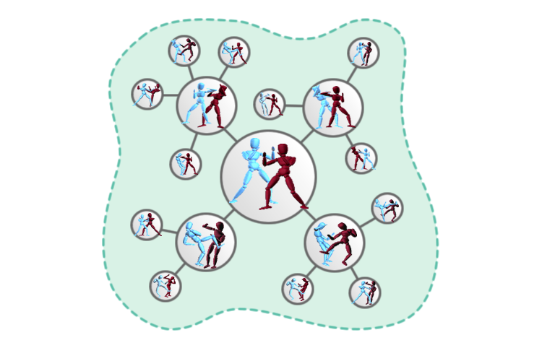
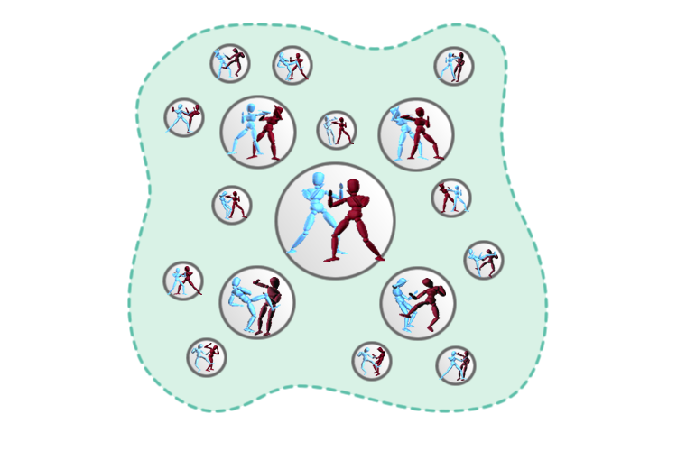
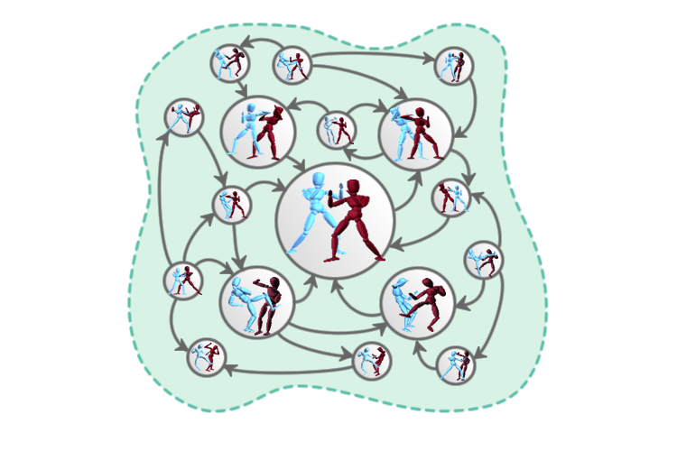
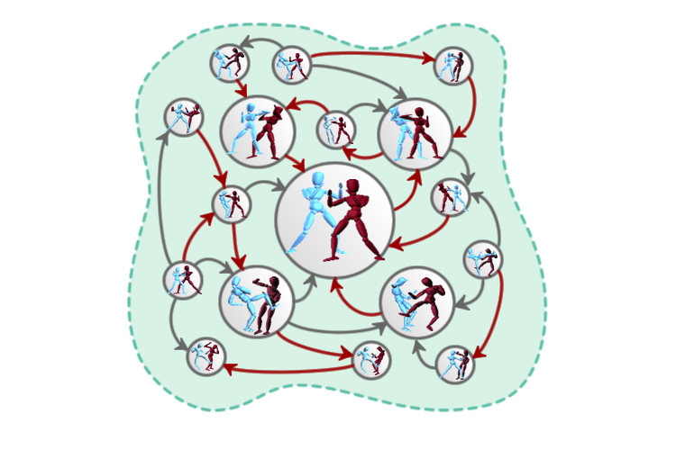
Interaction Graph - Precompute Optimal Actions for Each State of Interaction

Slide 7
Control Signal for Controllable Actions - Creating Control Signal Profiles for Controllable Actions
Using a Wiimote to gather 6 DOF acceleration
Pairing a control signal profile with each controllable action
Gathering control signal and perform action matching during run-time

Slide 8
Single Buffer Approach for Action Matching - Low Accuracy, Unable to Change Action after Initial Recognition
s₃
s₁
s₂
Current Action

Slide 9
Single Buffer Approach with Larger Buffer Size - Improved Accuracy, Long Time Lag for the Initial Match Result
s₁
s₂
s₃
s₄
s₅
Current Action

Slide 10
Proposed Dual Buffer Approach - Fast Response with High Accuracy
s₁
s₂
s₃
s₄
s₅
Supplementary Buffer
Main Buffer
Current Action

Slide 11
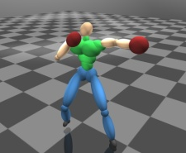
Control System - Separated Recognition Thread and Rendering Thread
Continue Current Action
Rendering Thread
Action Recognition Thread
Switch to New Action

Slide 12
Action Switching - Skip Frames from the Initial Action for Smoother Movements

Slide 13
Experiment Setup - The System Runs Efficiently on a Notebook Computer
Motion Database
7 mins. shadow boxing
148 semantic actions
13 Controllable Actions
2 straight Punches, 2 upper cuts, 2 hook punches
2 parries, 1 blocking
4 movements
System Setup
Core 2 Duo P8600 (2.4GHz) with 4GB RAM
0.1 sec. main Buffer
1 sec. supplementary buffer
5ms per recognition loop

Slide 14
Experiment: Controlling Character - 13 Controllable Actions, 0.1 Seconds Buffer, >90% Accuracy

Slide 15
Experiment: Boxing with Virtual Enemy - Opponent Controlled by the Interaction Graph

Slide 16
Buffer Size and Recognition Accuracy - Expert Player - Up to 95% Accuracy with a 6 Frames (0.1 sec.) Buffer
Accuracy (%)
Buffer Size (Frame)

Slide 17
Buffer Size and Recognition Accuracy - Novice Player - Action Switching Indicates the Effects of the Supplementary Buffer
Accuracy (%)
Buffer Size (Frame)

Slide 18
Conclusion
Proposed a dual buffer framework for real-time action matching
Perform an initial matching with minimal time lag
Capable of switching action when more signals arrive
Short response time with high accuracy
Future Directions
Adjusting actions based on user control signals
Improving the intelligence of the computer controlled character

Slide 19
Thanks!
Any Questions?

