Slide 1




A Two-Stream Recurrent Network for
Skeleton-based Human Interaction Recognition
Qianhui Men*, Edmond S. L. Ho†, Hubert P. H. Shum‡, Howard Leung*
*Department of Computer Science, City University of Hong Kong
†Department of Computer and Information Sciences, Northumbria University
‡Department of Computer Science, Durham University
Notes:
Hello everyone, I am Qianhui Men, I will present the work…. This is a joint work with …..

Slide 2

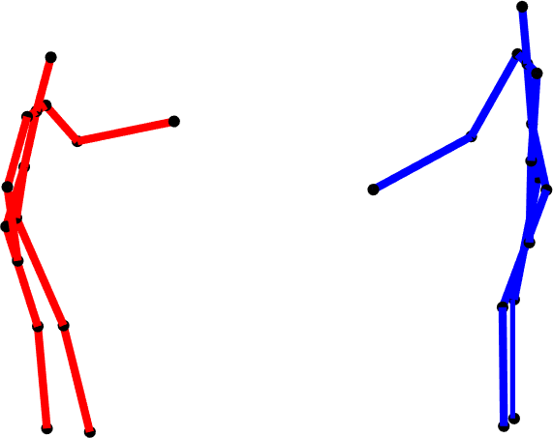
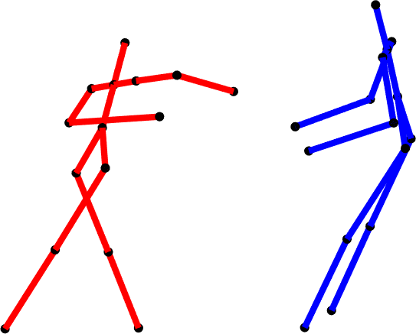
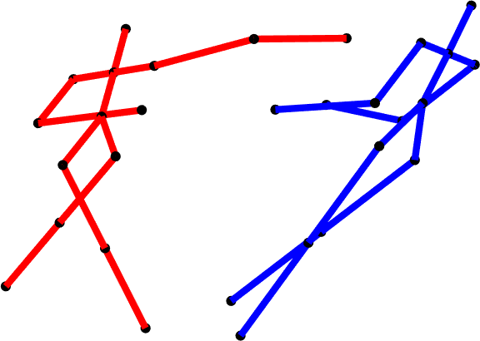

Introduction
Skeleton-based Action Recognition of Single Character
Skeleton-based Human Interaction Recognition
feature
learning
(1 character)
classification
Leap forward
feature
learning
(2 characters)
classification
…
Punching
…
learning complexity
A Two-Stream Recurrent Network for Skeleton-based Human Interaction Recognition, ICPR2020
Notes:
With the rapid development of motion sensing, human movements are easily captured with skeletal information.
Existing work mainly focus on recognizing the spatiotemporal patterns from a single character.
In this work, we address a more challenging problem of recognizing human-human interaction.
The challenge mainly comes from the large learning complexity in spatial domain since one more character appears in the scene.

Slide 3
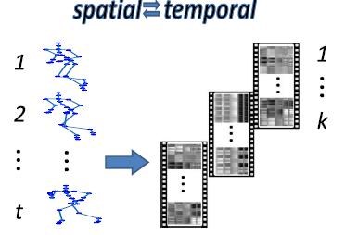
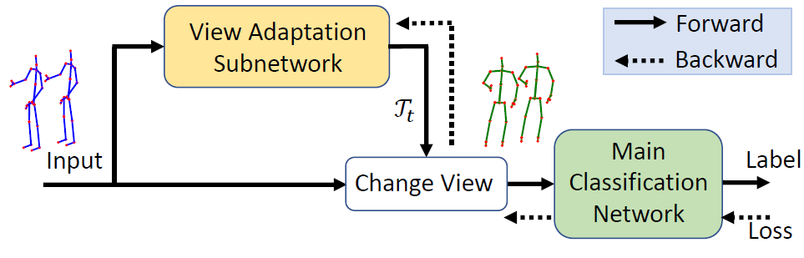
Related Work
Stacking joint features
Feature extraction from individual characters
[Fan et al. TMM, 2019]
[Ke et al. CVPR, 2017] [Zhang et al. TPAMI, 2019]
A Two-Stream Recurrent Network for Skeleton-based Human Interaction Recognition, ICPR2020
Notes:
Some of the existing work for action and interaction recognition mainly focus on modeling temporal variations, while in spatial domain only stacking joint features .
The lack of exploring spatial correlations among joints will lead to the ambiguity when representing actions.
Other branch of work only extracts features from individual characters, while ignoring the abundant mutual information between characters.

Slide 4

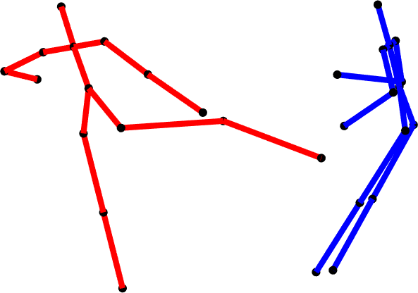
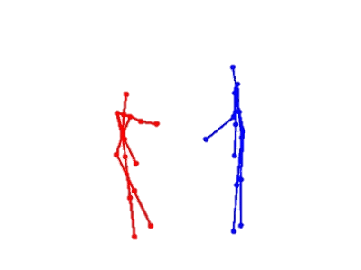
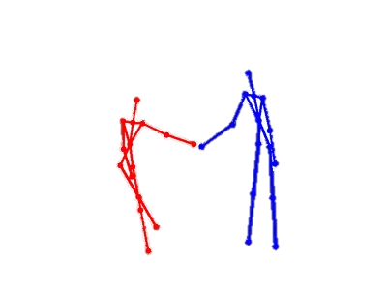
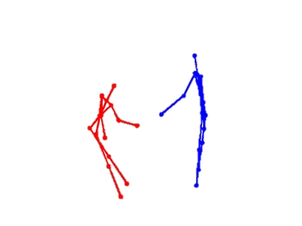
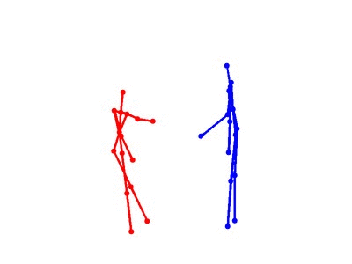
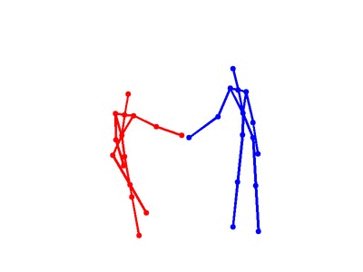
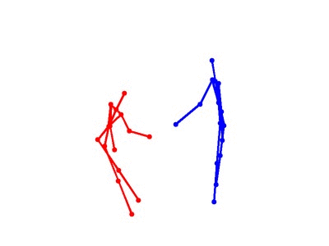






Methodology
Pairwise Joint Distance BiLSTM (PJD-BiLSTM)
PJD-BiLSTM
…
…
LReLU
Dense
score
$$h_{1}$$
$$h_{t−1}$$
$$h_{T}$$
$$d_{1}$$
$$d_{2}$$
$$d_{t}$$
kicking
…
punching
x
x
x
y
y
y
…
z
z
z
better at discriminating explicit patterns
: LSTM cell
: concatenation
A Two-Stream Recurrent Network for Skeleton-based Human Interaction Recognition, ICPR2020
Notes:
In this work, we propose a two-stream recurrent network to jointly learn the explicit and implicit correlations with the two characters.
We first propose a PJD-BiLSTM to learn the explicit spatial-temporal dependencies by modeling the correlations between all joint pairs of two characters.
By modeling joint-pair level correlations, this stream is better at discriminating interactions with distinct patterns, such as kicking and punching that dominants by different body parts.

Slide 5



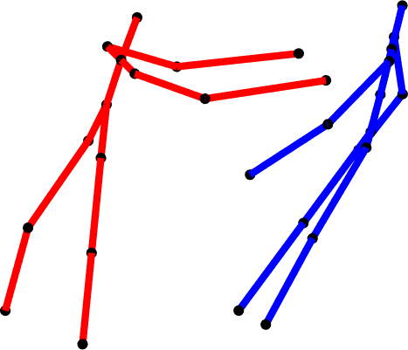











Methodology
Fully-Connected Graph Convolution BiLSTM (FCGC-BiLSTM)
$$D_{t}$$
…
$$X_{t}$$
x
x
x
…
A
pushing
y
z
y
z
y
z
FCGC-BiLSTM
$$D_{1}$$
$$D_{2}$$
$$D_{t}$$
…
…
punching
$$X_{1}$$
$$X_{2}$$
$$X_{t}$$
$${\tilde{h}}_{1}$$
…
$${\tilde{h}}_{t−1}$$
$${\tilde{h}}_{T}$$
…
score
LReLU
Dense
better at discriminating implicit patterns
: LSTM cell
: FCGC cell
: element-wise product
: concatenation
A
: adaptive adjacency matrix
: matrix multiplication
A Two-Stream Recurrent Network for Skeleton-based Human Interaction Recognition, ICPR2020
Notes:
We then propose a FCGC-BiLSTM to capture implicit correlations by representing the interaction as graph, where the skeletal joints of the two characters are regarded as graph nodes.
The node connectivity of the graph is represented by A, and we make it to be adaptive to increase the flexibility of the graph representation.
We also incorporate the PJD features from the fully-connected graph as auxiliary information to support the spatial proximity in the graph structure.
By modeling joint-level correlations, this stream is able to tell interactions with subtle differences, such as pushing and punching.

Slide 6
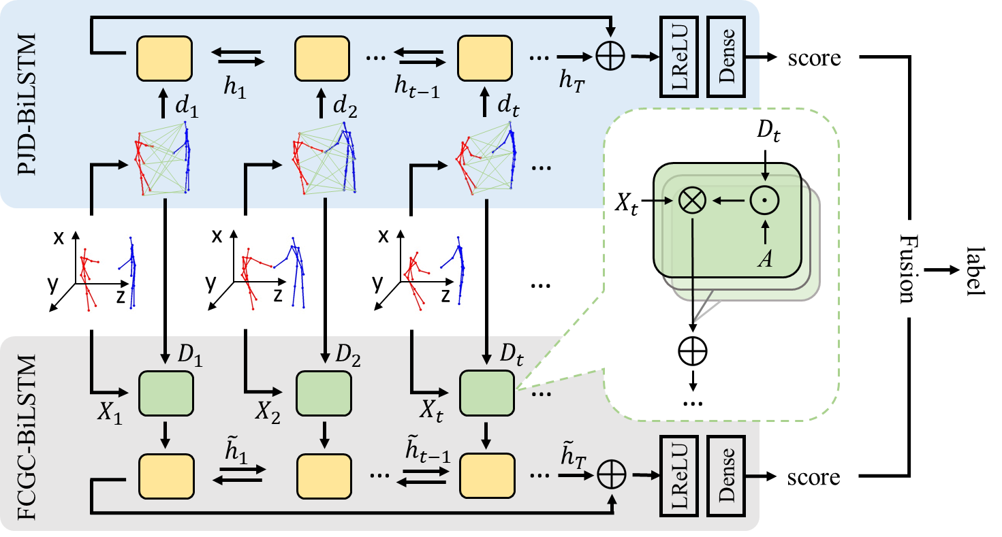


Methodology
Overall framework
Late Fusion
Principle of Maximum Entropy
Fusion
Larger entropy indicates a discriminative classification.
A Two-Stream Recurrent Network for Skeleton-based Human Interaction Recognition, ICPR2020
Notes:
We then propose a late fusion algorithm to take advantage of both streams by combining their prediction scores.
The final score of each interaction sample is weighted from the two separate streams, and more weights are given to the stream with a larger information entropy that indicates a more discriminative classification of the certain interaction.

Slide 7
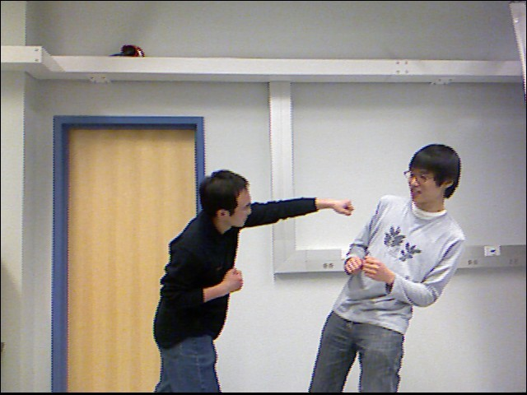
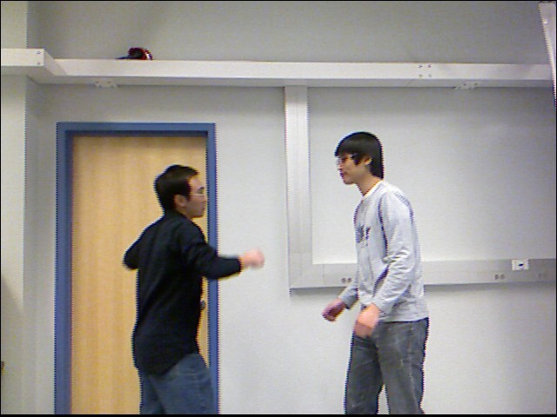
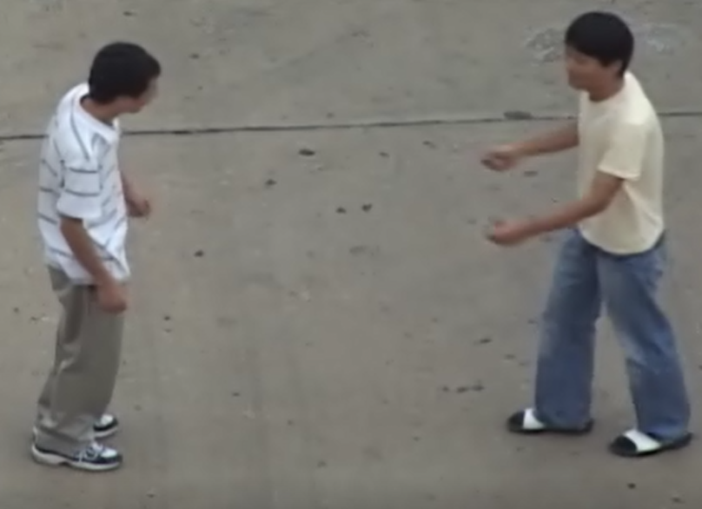
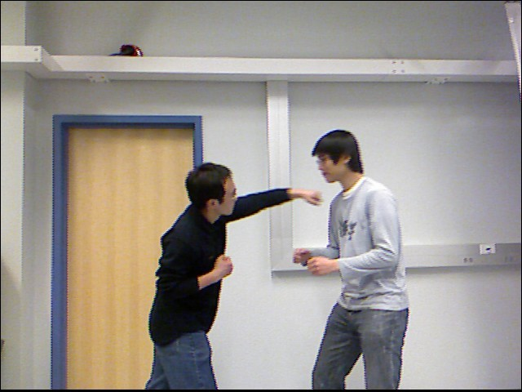
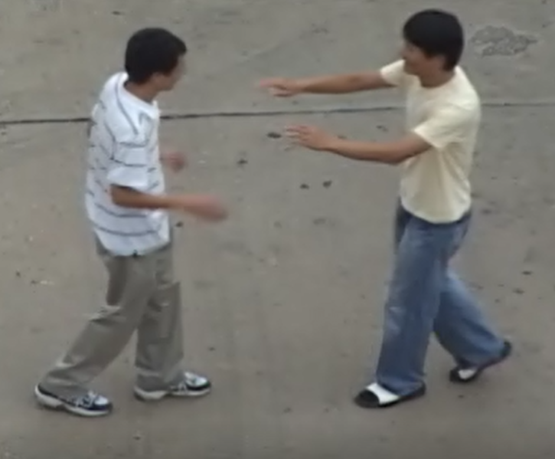
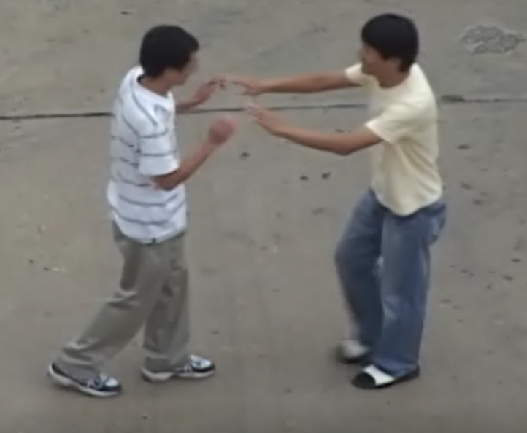
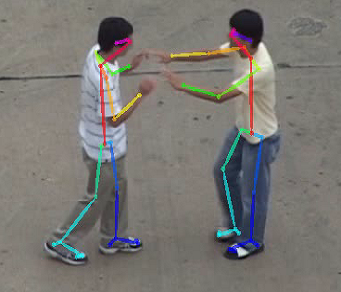
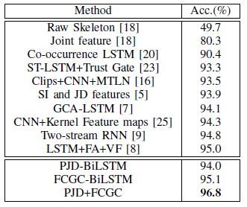
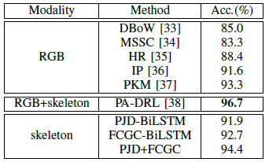
Experiments
SBU Interaction Dataset
  3D Skeleton Video
UT Interaction Dataset
  2D Key joints in RGB Video
A Two-Stream Recurrent Network for Skeleton-based Human Interaction Recognition, ICPR2020
Notes:
In the experimental results, we achieve the state-of-the-arts on the benchmark 3D interaction dataset.
And the late fusion has shown its advantage over single streams.
To test the generality of our work, we also evaluate on 2D key joint in RGB videos, and we outperform the models using RGB features and achieve comparable results with the modality of RGB plus skeleton.

Slide 8
Summary
A pairwise joint distance BiLSTM network (PJD-BiLSTM) that models the explicit interaction patterns from the discriminative geometric features.
A fully-connected graph convolution BiLSTM network (FCGC-BiLSTM) that quantifies the spatial proximity of interaction from joint positions to extract the implicit correlations among joints.
A late fusion algorithm is defined to boost the recognition accuracy from probability outputs of both streams.
State-of-the-art recognition performance on 3D interaction dataset. Can be easily extended to 2D key joint recognition with comparable results.
A Two-Stream Recurrent Network for Skeleton-based Human Interaction Recognition, ICPR2020
Notes:
In the future, we would like to combine RGB features and skeleton information to jointly learn the representative features for human interaction.

Slide 9
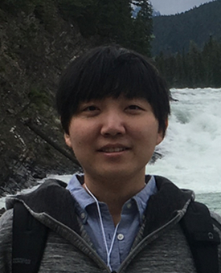
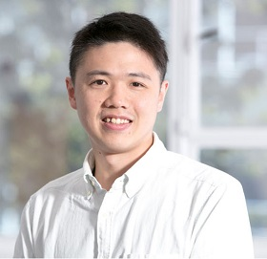
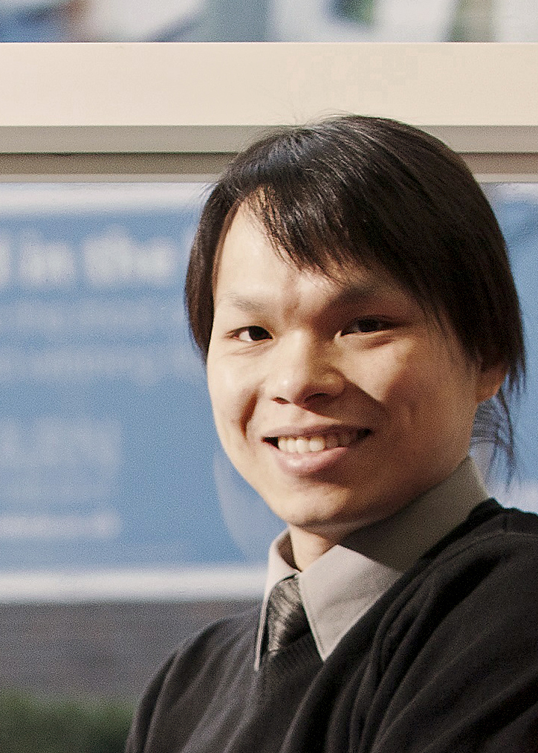
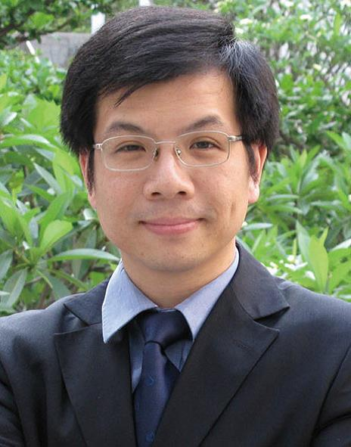
Thank you for watching!
Questions / Comments please contact: qianhumen2-c@my.cityu.edu.hk
Our Team:
Qianhui Men
Edmond S. L. Ho
Hubert P. H. Shum
Howard Leung

Slide 10
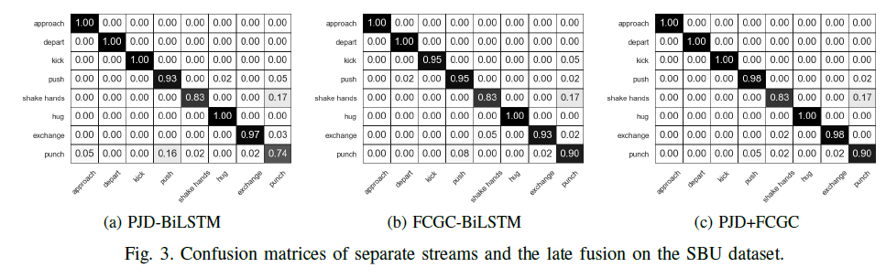
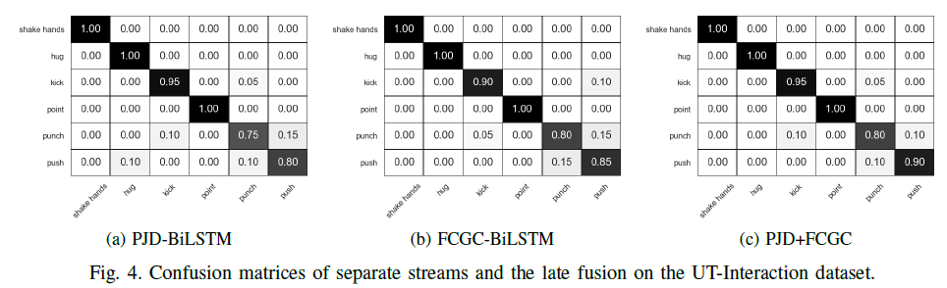
Confusion Matrix

Slide 11
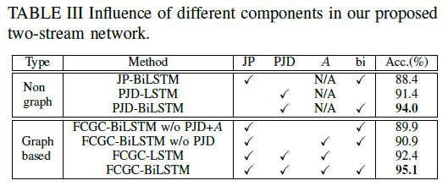
Ablation Study

