Slide 1
Simulating Interactions of Avatars in High Dimensional State Space
Hubert P. H. Shum RIKEN
Taku Komura University of Edinburgh
Shuntaro Yamazaki AIST

Slide 2
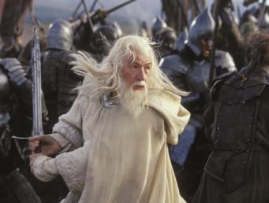
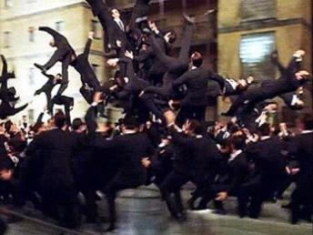
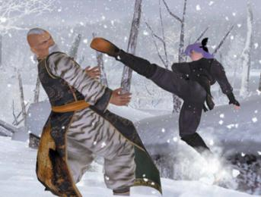
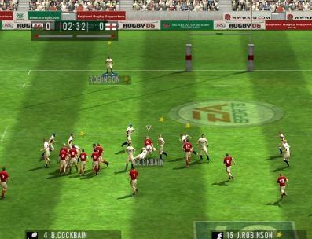
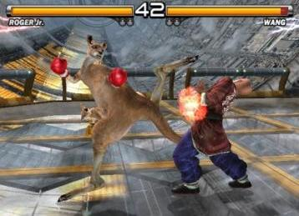
Character Animation - Huge Demand but Little Research, Especially for Interactions

Slide 3
Motion Capture with Single Actor - More Easy and Safe Motion Capture

Slide 4
Action Level Motion Graph - Reorder Captured Motion to General New Motion
Punch
Dodge
Avoid
Walk
Kick
Avoid
Avoid
Punch
Walk
Punch
Walk
Kick
Dodge
Kick
Dodge

Slide 5
Precompute Optimal Actions - Each Point in the State Space Represents a State of Interaction

Slide 6
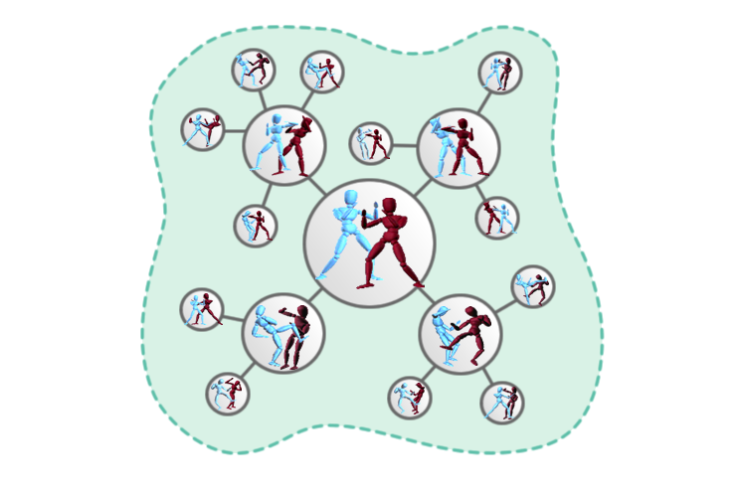
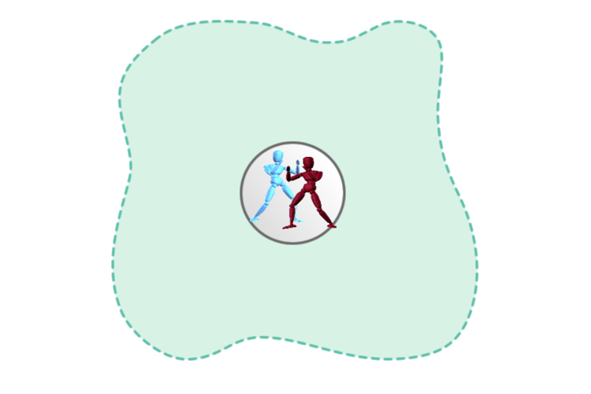
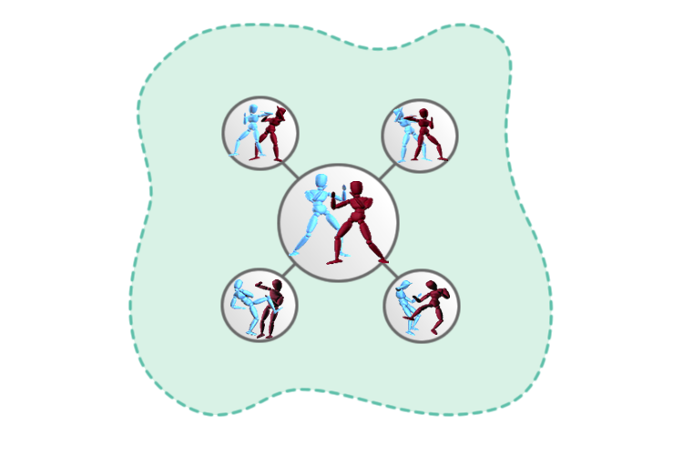
Sampling State Space - Expand a Huge Tree and Sample Meaningful States Only

Slide 7
Off Policy Sampling - Difference Functions for Evaluation and Sampling
Motion Evaluation Function
Damage to / from Enemy
Movement and Rotation
Sampling Function
Amount of Interaction
Connectivity to Other Nodes

Slide 8
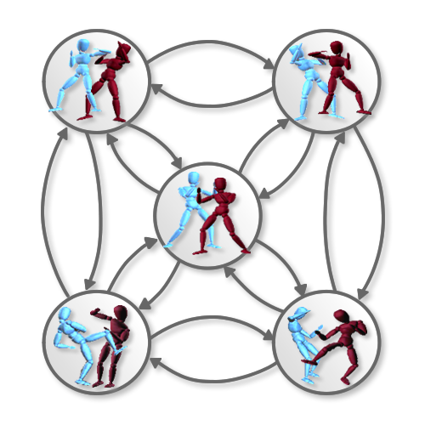
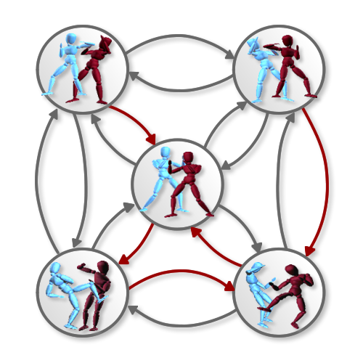
Interaction Graph - Evaluate Optimal Actions for Each Node

Slide 9
Real-Time Simulation - Controllable Character Interacting in Real-Time

Slide 10
Competitive Interactions - Adjusting Intelligent of the Computer Controlled Characters

Slide 11
Competitive Interactions - Adjusting Fighting Style of the Computer Controlled Characters

Slide 12
Cooperative Interactions - Controlling Movements of the Characters

Slide 13
Crowd Interactions - Simulating a Lot of Characters in Real-Time

Slide 14
Thanks!
Any Questions?

