Slide 1
Data-Driven Crowd Motion Control with Multi-touch Gestures
Hubert P. H. Shum
Associate Professor (Reader) Director of Research and Innovation Northumbria University, UK

Slide 2
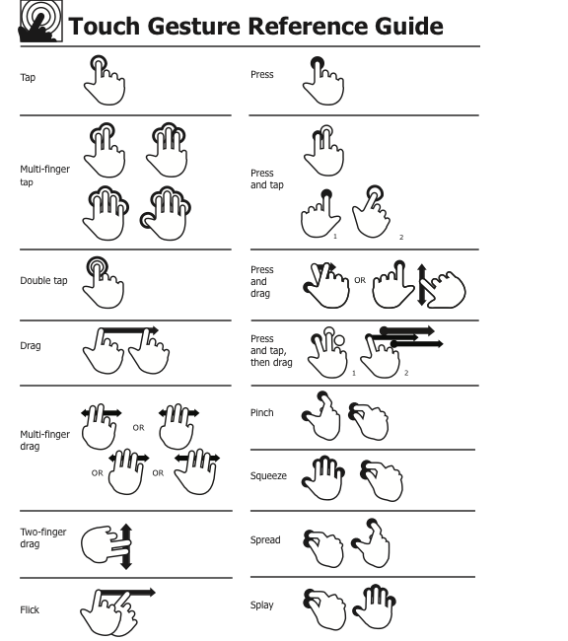
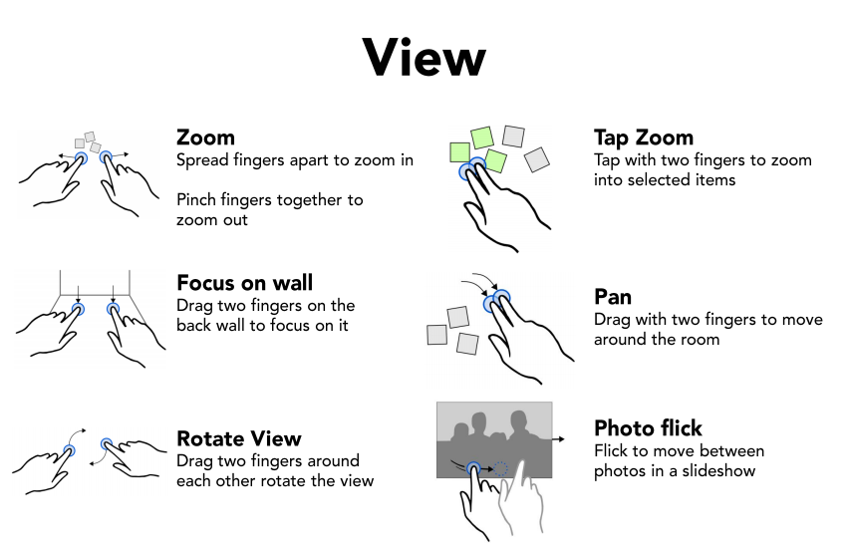
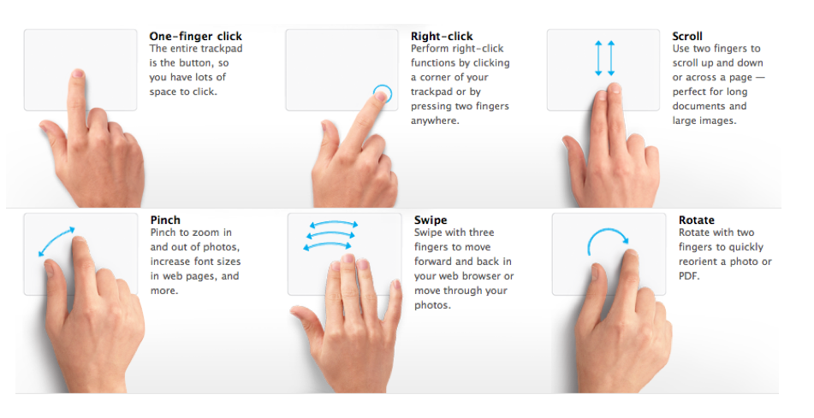
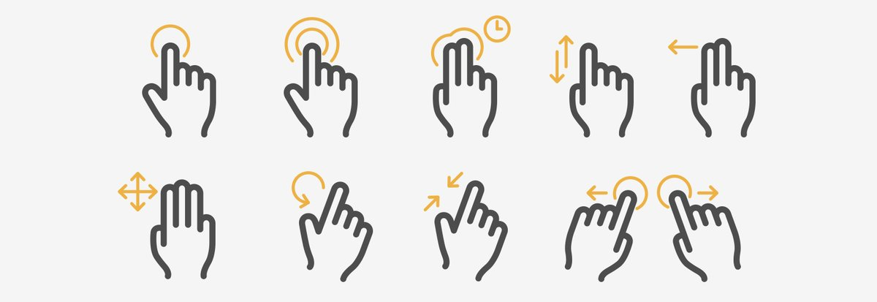
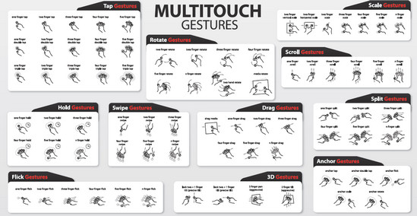
Pre-defined Control Schemes for Multi-touch Gestures

Slide 3
Intuitive Crowd Controls with Multitouch Gestures

Slide 4
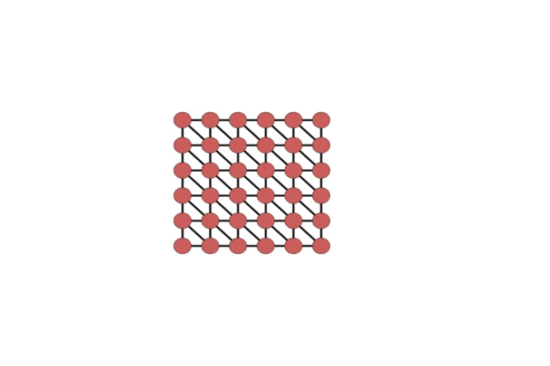
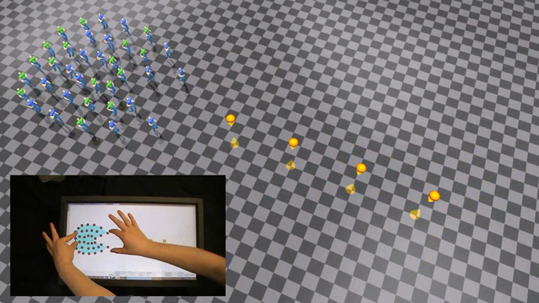
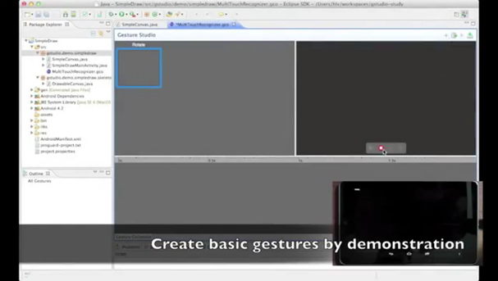
Previous Work in Gesture-based Formation Controls
Environment-aware Real-Time Crowd Control, SCA 2012
Interactive Formation Control in Complex Environments, TVCG 2014
Gesture studio: Authoring Multi-touch Interactions through Demonstration and Declaration, CHI 2013

Slide 5
Contributions
How to obtain the intuitive multi-touch gestures for crowd controls?
How can the system represent and recognize these gestures for crowd control?

Slide 6
Contributions
How to obtain the intuitive multi-touch gestures for crowd controls?
Data-driven framework
How can the system represent and recognize these gestures for crowd control?
Gesture features independent of the number of finger
Crowd motion features independent on the number of characters
Real-time controls with light-weight run-time (lazy) machine learning

Slide 7
Offline Processes

Slide 8
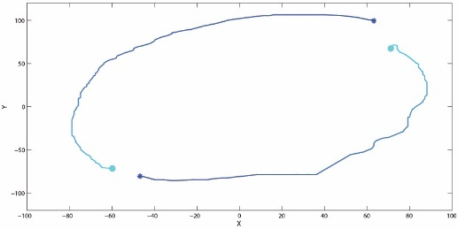
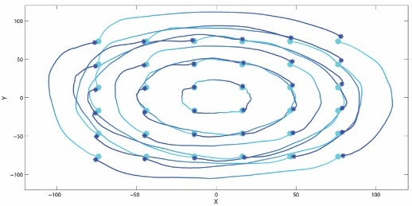
Captured Gesture Trajectories
Precomputed Crowd Motion Trajectories
Gesture Features
Crowd Motion Features
Gesture Space
Crowd Motion Space
Offline

Slide 9
Database: Crowd Motion & Hand Gesture Pairs
Crowd motion clips synthesized by Henry et al. 2014

Slide 10
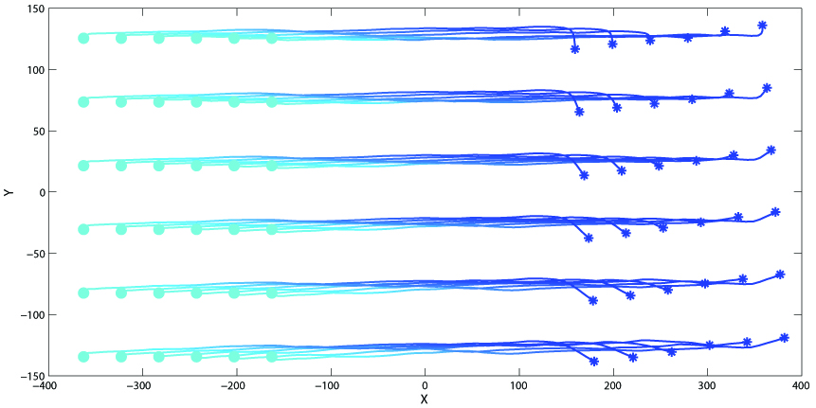
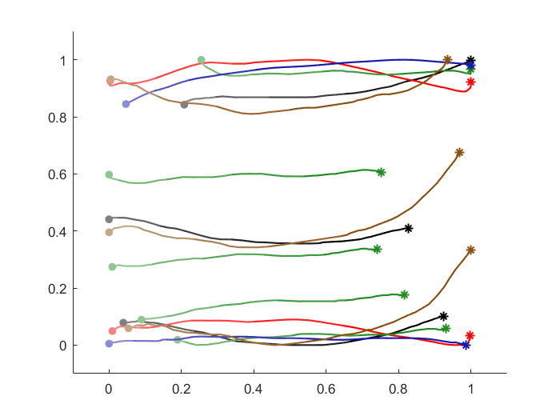
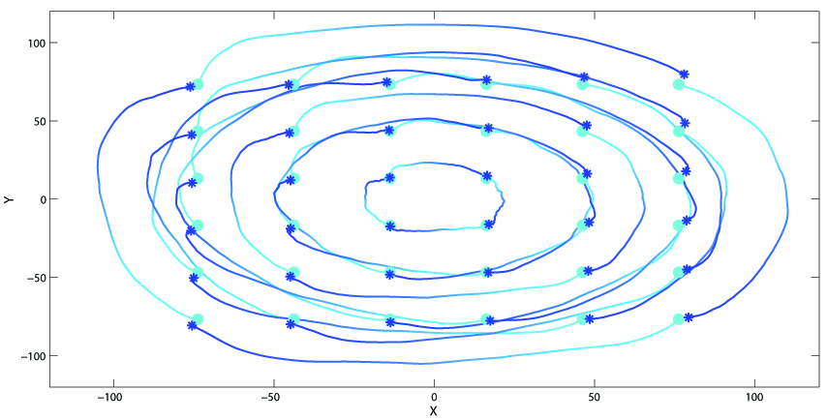
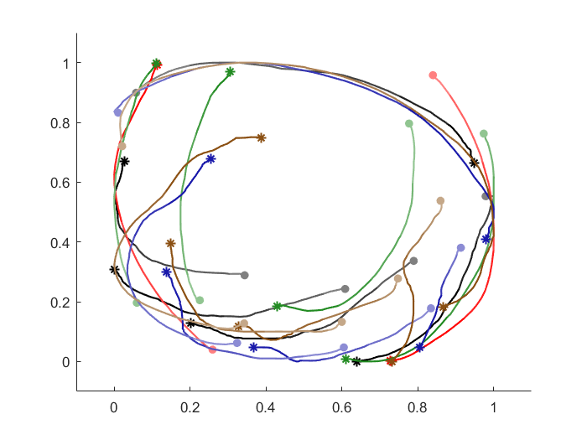
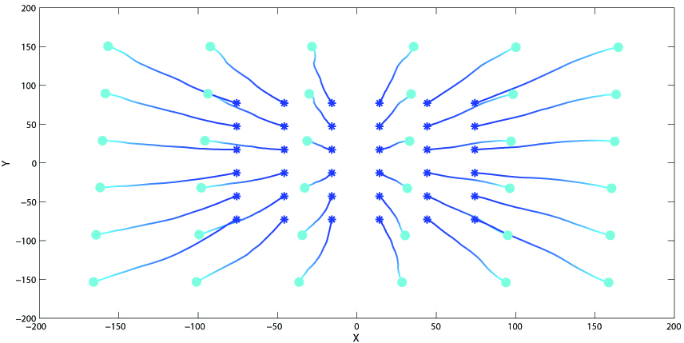
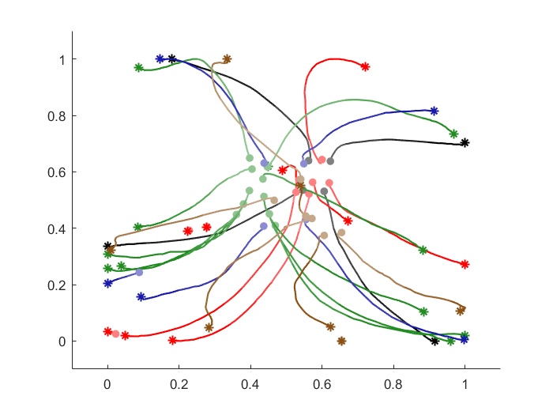
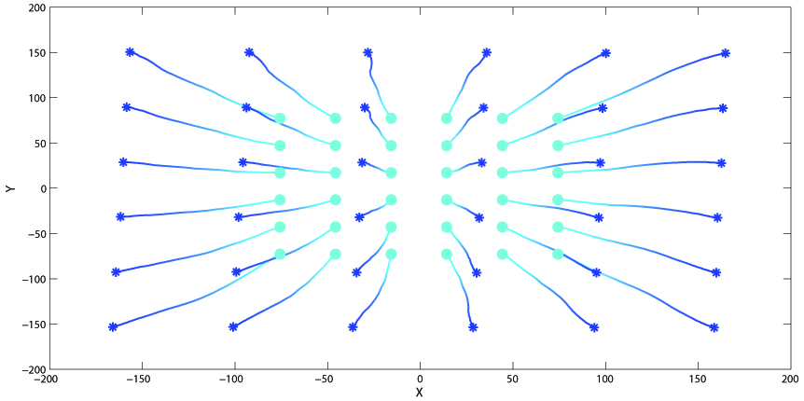
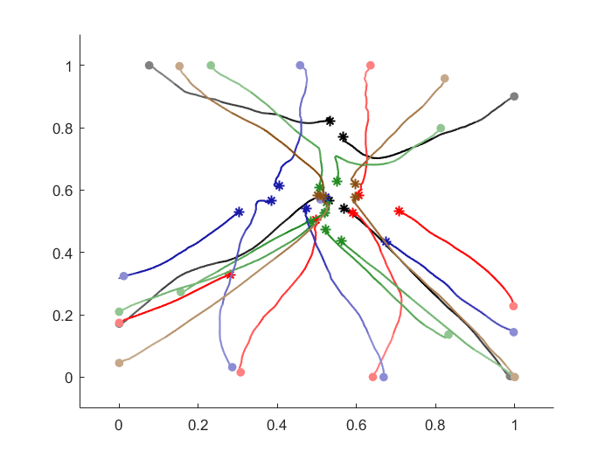
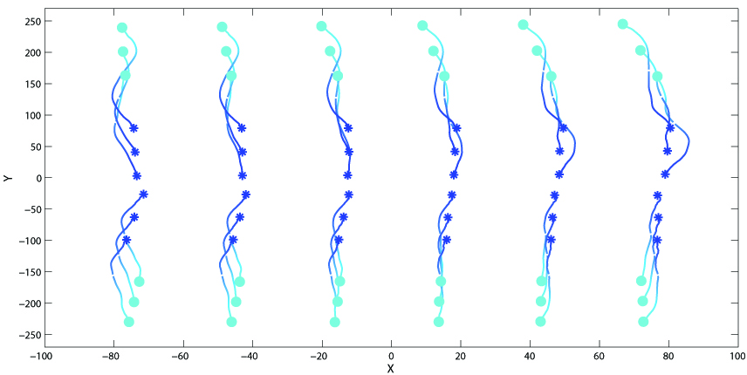
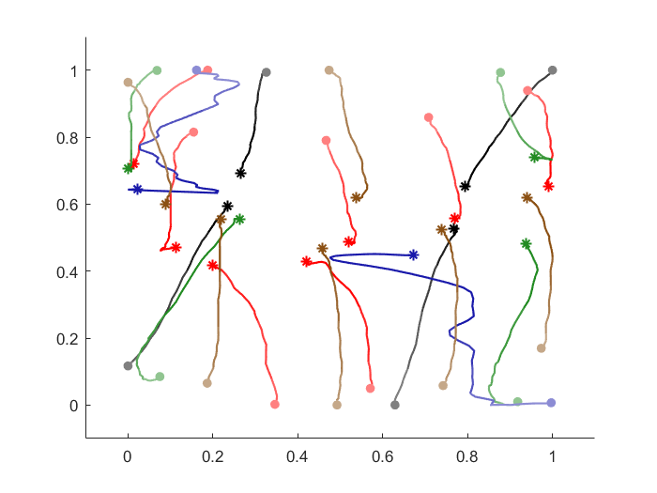
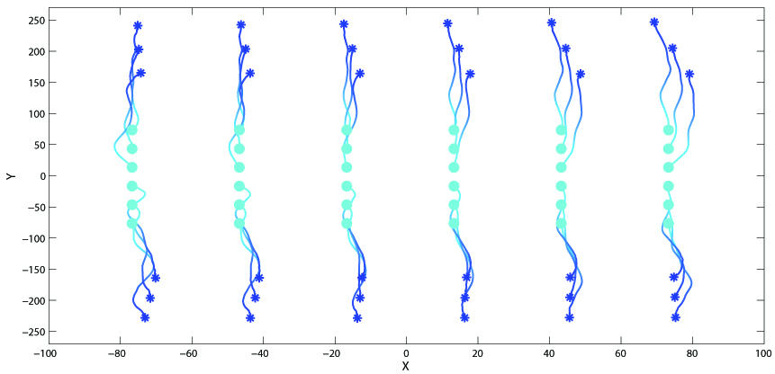
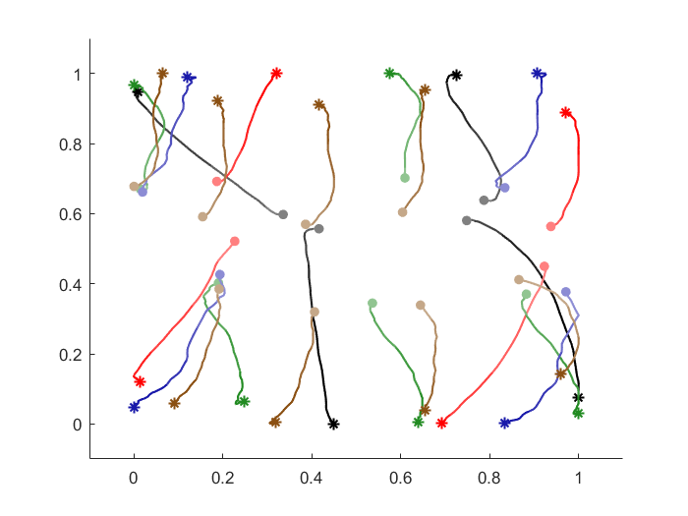
Crowd Motion & Hand Gesture Pairs Collected

Slide 11
Generalized Hand Gesture Features
Raw data
Multiple trajectories of fingers
Extracted features for each gesture → Gesture Space
Centroid of touch points for all frames, C
Average distance to centroid for all frames, S
Average rotation around centroid for all frames, R
Minimum oriented bounding box for all frames, B
Advantages of the Gesture Space
Low dimensional, continuous
Independent of the number of fingers used

Slide 12
Distance between Hand Gestures
Two gestures
Weight
Dynamic time wraping

Slide 13
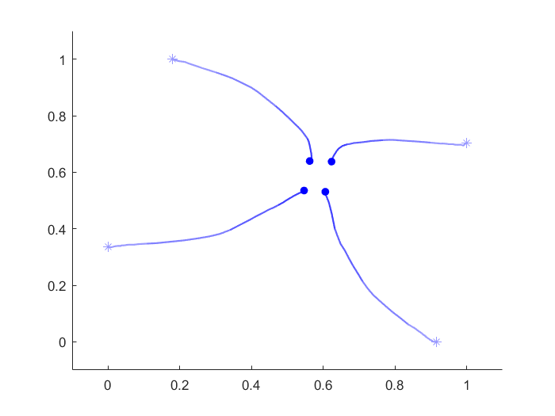
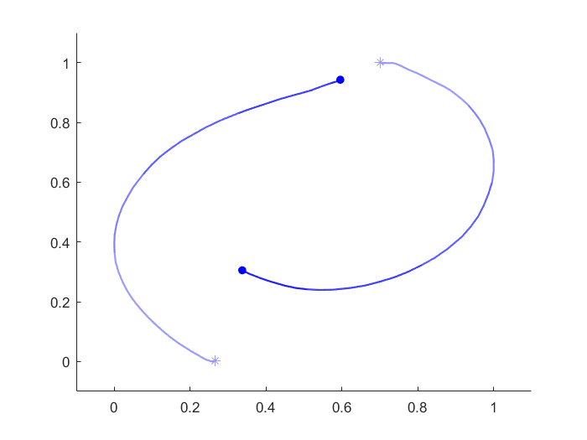
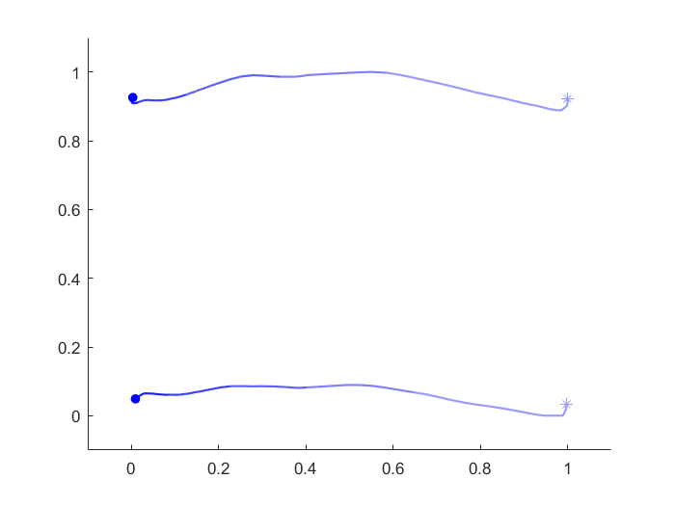
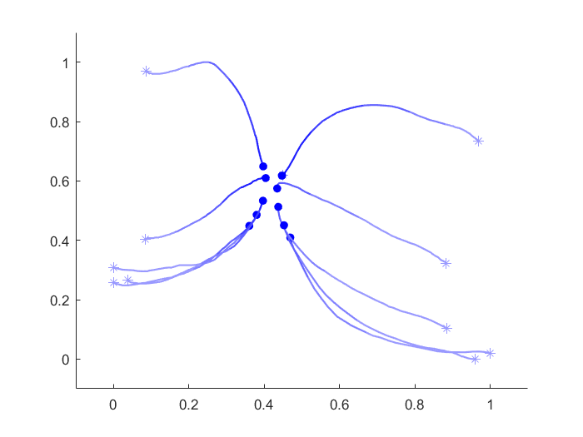
Example Distances Calculated
D(G₀, G₁) = 6.1980
D(G₀, G₁) = 0.7064

Slide 14
Generalized Crowd Motion Features
Raw data
Multiple trajectories of characters
Extracted features for each crowd motion → Crowd Motion Space
Re-sampling the trajectories to a standard length
PCA to reduce the dimensions of the trajectories into Eigen vectors and Eigen scores
Gaussian mixture model to represent the distribution of the Eigen scores
Represented by the mean & variance of each Gaussian
Two Gaussian used
Advantages
Low dimensional, continuous
Independent of the number of characters in the crowd
Gaussian Model
Eigen score representing a trajectory
Probability distribution
Mean
Variance
Gaussian Mixture Model

Slide 15
Online Processes

Slide 16
Generating Crowd Motions with Run-time Gestures - Traditional Machine Learning
Sample Data in Database (Position → Gesture, Color → Crowd motion)
Abstraction of Data (Crowd Motion)
Run-time Query (Run-time Gesture)
Value Estimation (Run-time Crowd Motion)

Slide 17
Generating Crowd Motions with Run-time Gestures - Our Proposed Lazy Learning
Sample Data in Database
(Position → Gesture, Color → Crowd motion
Run-time Query
(Run-time Gesture)
Using runtime information to reduce the scale of training
Complex data modelling not required
Excellent for small datasets with large variations
Higher run-time cost
Run-time Abstraction of Data (Crowd Motion)
Value Estimation
(Run-time Crowd Motion)

Slide 18
Captured Gesture Trajectories
Precomputed Crowd Motion Trajectories
Gesture Features
Crowd Motion Features
Gesture Space
Crowd Motion Space
Offline
Online
Search for K Nearest Gesture Neighbors
Interpolate K Corresponding Crowd Motion
Run-time Gesture Trajectories
Run-time Gesture Features
Run-time Crowd Motion Features
Run-time Crowd Motion Trajectories

Slide 19
Results

Slide 20
Navigating through Complex Environments

Slide 21
Avoid Obstacles

Slide 22
Using a Different Database

Slide 23
Less Accurate Gestures

Slide 24
Conclusions
A data-driven method for inferring an appropriate crowd motion based on a multi-touch gesture input
Representing gestures using features that are invariant to the number of fingers used
Representing crowd motions using features that are invariant to the number of characters
Discussions
Gesture interpolation capability
Future directions on advanced machine learning (with a bigger database)

Slide 25
The End
More information: http://info.hubertshum.com

