Slide 1
Interpreting Deep Learning based Cerebral Palsy Prediction with Channel Attention
Manli Zhu¹ Qianhui Men² Edmond S.L. Ho¹ Howard Leung² Hubert P.H. Shum³
¹Department of Computer and Information Sciences, Northumbria University
²Department of Computer Science, City University of Hong Kong
³Department of Computer Science, Durham University

Slide 2
Background
Cerebral palsy (CP) is one of the most common childhood neurodevelopmental disorders in the United States [1].
Between 3 to 10 out of 1,000 children develop some form of CP depending on gestational age at birth [2].
Early diagnosis of CP is essential.
[1] Novak, Iona, et al. "Early, accurate diagnosis and early intervention in cerebral palsy: advances in diagnosis and treatment." JAMA pediatrics, 2017.
[2] Anderson, Peter, et al. "Neurobehavioral outcomes of school-age children born extremely low birth weight or very preterm in the 1990s." jama, 2003.

Slide 3
Related Works
Automated General Movement Assessment (GMA) methods [3]
-- Time-consuming
-- Require human interference
Machine learning and deep learning methods [4][5]
-- Heavily rely on hand-crafted features
-- Hard to interpret
[3] Qingqiang Wu et al. "Rgb-d videos-based early prediction of infant cerebral palsy via general movements complexity." IEEE Access, 2021.
[4] Kevin D. McCay et al. “Establishing Pose Based Features Using Histograms for the Detection of Abnormal Infant Movements”. EMBC 2019.
[5] Kevin D. McCay et al. “Abnormal Infant Movements Classification With Deep Learning on Pose-Based Features”. IEEE Access 2020.

Slide 4
Main Contribution
In this paper, An interpretable deep learning framework is designed for CP prediction.
We present a channel attention module.
We propose a novel attention loss function.
We visualize the joints attention values for interpretation.

Slide 5
Our Framework
_{Squeeze}
_{Excitation}
_{Attention}
Conv2D
S
z
$$σ$$
A_{z}
Conv2D
_{Kernel: (3, 1)}
_{Stride: (3, 1)}
S'
_{Joint Position}
T
Conv2D
.
.
.
1×1×J
Label
1×1×J
Conv2D
···
···
T
C
C
Conv2D
J
J
FC
Softmax

Slide 6
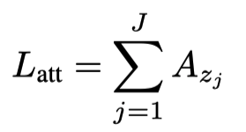
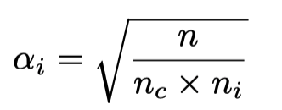
Loss Function
Final Loss Function:
Attention Loss:
A_{zj} : the attention value of joint j
Class Balancing Weight Function:
n : the number of total samples
n_{c} : the number of classes
n_{i} : the number of samples of class i

Slide 7
The MINI-RGBD Dataset
We verify our model on the Moving INfants In RGBD synthetic dataset (MINI-RGBD) [6].
Infant age: All infants in the dataset are a half year old
Data size: 12 video sequences
Label: 8 of 12 sequences were labeled as abnormal, and 4 were labeled as normal.
[6] Hesse, Nikolas, et al. "Computer vision for medical infant motion analysis: State of the art and rgb-d data set." ECCV Workshops, 2018.

Slide 8
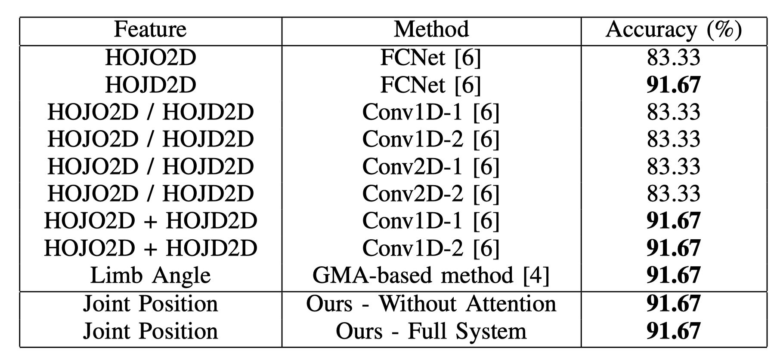
Quantitative Evaluation
Classification accuracy comparison between our proposed method and other baseline methods

Slide 9
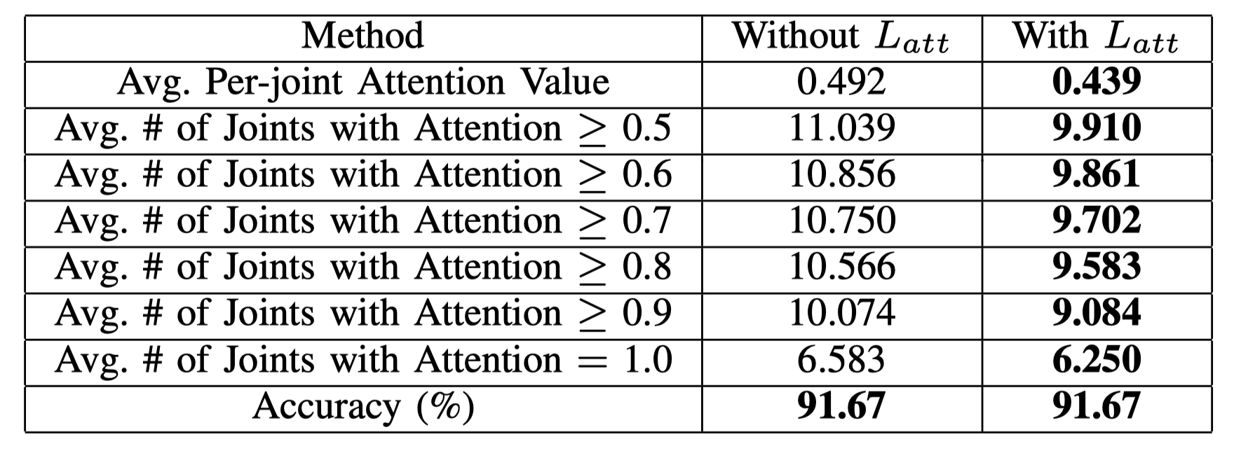
Quantitative Evaluation
The influence of the attention loss in our framework

Slide 10
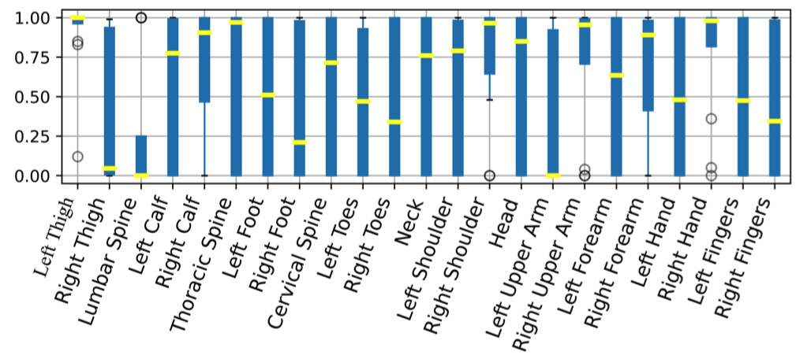
Visualization for Interpretation
The visualization of attention values of all joints across twelve validations

Slide 11
Visualization for Interpretation
The visualization of joints attention in two cross-validations with a normal sample (upper row) and an abnormal sample (lower row) as validation.

Slide 12
Conclusion
We propose an interpretable deep learning framework with channel attention for Cerebral Palsy prediction.
We propose an attention loss for minimizing the number of attended joints for better human understanding and analysis.
We visualize the attention values of joints for interpreting the proposed deep learning framework.

Slide 13
Thank You!

